Slide 1
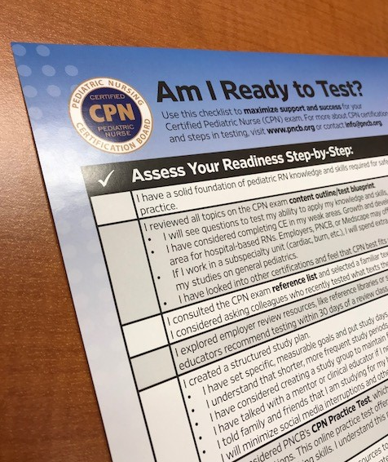
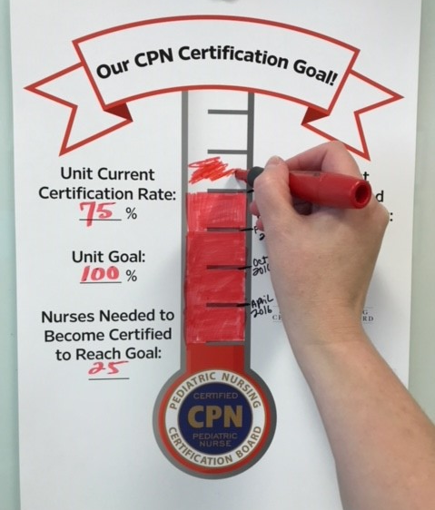
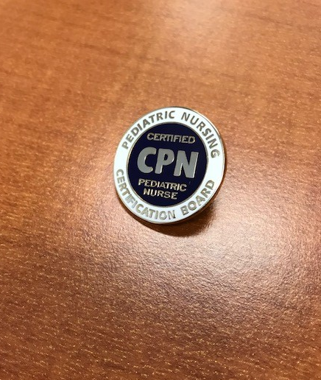
CPN Certification
A Guide for Nurses & Those Supporting the Journey to Certified Pediatric Nurse (CPN®)

Slide 2
Thank you!
Pediatric Nursing Certification Board (PNCB) appreciates your time in learning about CPN certification.
This PowerPoint is for:
RNs considering certification
Nurses mentoring interested RNs and nurse residency program staff
Educators, professional development staff, and others supporting certification
Leadership, Magnet Program Directors, HR, and other administrators

Slide 3
Why Get Certified?
There are many reasons to aim for certification, such as:
Personal satisfaction
Demonstration of expertise or meeting a recognized standard
Increased confidence
Commitment to patient care
Professional rewards and growth
What does your employer offer for getting certified?
Ask a colleague or mentor why they sought certification.

Slide 4
About CPN
The Certified Pediatric Nurse credential is earned after taking a secure, proctored exam.
More than 90% of RNs seeking certification choose PNCB’s CPN exam
There are 26,000+ active CPNs
The first-time pass rate was 78% in 2017.
CPN certification isn’t limited to hospital RNs or direct care RNs
  61% direct care
  39% other
  Held by consultants, educators, researchers, CNOs, and other roles

Slide 5
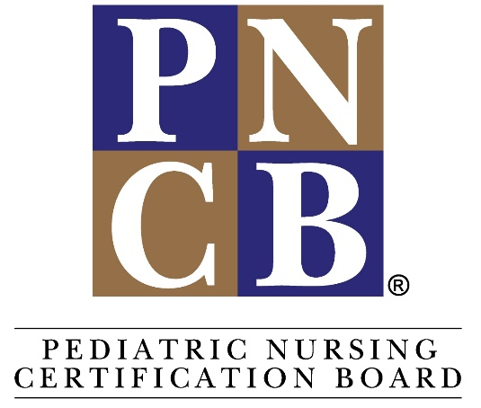
About PNCB
Largest pediatric nursing organization in North America.
  43,000+ active certificants, including CPNPs and Pediatric Primary Care Mental Health Specialists (PMHSs)
Established in 1975 for Pediatric Nurse Practitioner certification (CPNP)
Launched the CPN exam in 1989
Endorsed by the American Academy of Pediatrics, the Society of Pediatric Nurses, and the National Association of Pediatric Nurse Practitioners
Supports our specialty in many ways, like the Institute of Pediatric Nursing
Strengthening care for children is at the heart of all we do!

Slide 6
CPN Exam Eligibility
RN license
  Current, valid, unrestricted, and unencumbered Registered Nurse license in the U.S., Canada, American Samoa, Guam, Northern Mariana Islands or the U.S. Virgin Islands at the time of application
Experience
PATHWAY 1
A minimum of 1800 hours of pediatric clinical experience completed within the past 24 months as an RN
OR
PATHWAY 2
A minimum of 5 years as an RN in pediatric nursing and 3,000 hours in pediatric nursing within the last 5 years with a minimum of 1000 hours within the past 24 months (use only if unable to meet the option at left)

Slide 7

Eligibility tips
You may have a diploma, associate's, bachelor's, master's, or higher nursing degree.
Hours earned in a pediatric nursing residency program count toward the requirement.
Have 1800 hours but haven’t reached the 24 months of experience? You do not have to wait to apply. The 24 month requirement is to ensure experience is recent.
The CPN exam is not just for hospital RNs. Other eligible experience could be direct patient care in ambulatory or public health settings and/or teaching, administration, clinical research, school-based care, home health care, or consultation in pediatric nursing.
Only select Pathway 2 if you do not meet Pathway 1.

Slide 8

What’s involved?
Get ready: prepare & apply
Take the exam
Maintain certified status through recertification
Step 3
Stay Certified
Step 2 Test
Step 1 Get Ready

Slide 9
1. Prepare & Apply
Things to know before you test

Slide 10

What to expect
The exam is
Computer-based
  At a local Prometric Testing Center
  You will schedule an appointment after your application is approved
Scheduled for a maximum time period of 3 hours
175 multiple choice questions
  Analysis and knowledge application type questions
  Not knowledge recall questions
  No penalty for guessing

Slide 11
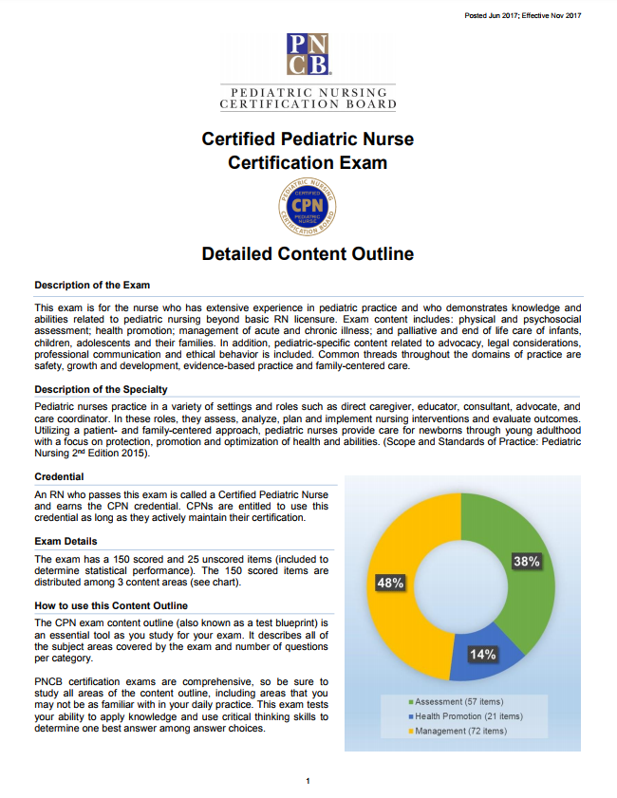
Preparation BASICS
PNCB doesn’t ‘teach to the test’ or offer review courses. We consider this a conflict of interest. You bring your knowledge to the exam.
PNCB offers these resources to support your study strategies:
Am I ready to test? checklist
  A list of all resources in 1 place
The exam content outline
  Your #1 tool to start your studies… what knowledge will the exam test?
Reference list
  Choose 1 of the respected textbooks our item writers use
Sample questions and practice tests
  CPN exam questions test your ability to analyze and apply knowledge, not knowledge recall

Slide 12
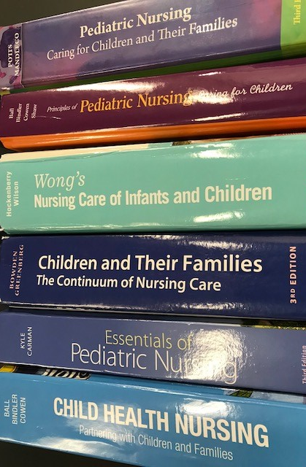
Reference LIST
You don’t need to study all the references listed at https://www.pncb.org/cpn-exam-resources.
PNCB recommends you use ONE pediatric nursing textbook that you are familiar with to review for the exam.
This text should also focus on the subject areas covered by the CPN exam content outline.
PNCB does not endorse nor have any proprietary relationship with any of the following textbooks or their publishing companies.
Tester Tip! Know colleagues who recently passed? Ask which texts and resources they found most helpful.

Slide 13

Gather tools & Support
Download the CPN exam content outline. Review all topics.
  What are your weak areas? Use a textbook or CE to help.
  Growth and development can be a weak area for hospital-based RNs.
  Sub-specialty RNs need extra time in review for general peds.
Can your employer offer study space, time to study, or help coordinate study groups?
Is there a hospital or unit library?
Does your employer offer a review class or other support?
Review course at Huntington Hospital

Slide 14

Got mentors?
Is there a CPN Champion where you work? They can help you navigate the process and cheer you on.
Identified your weak areas on the exam content outline? Connect with an experienced nurse with these areas as their strengths.
CPN Champion Charolette Jones (center, in pink) with CPN colleagues at Children’s of Alabama

Slide 15
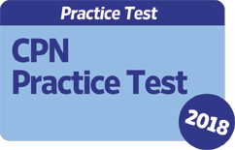
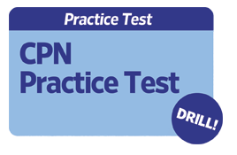
USING a CPN PRACTICE TEST
Some of PNCB’s practice tests have in-depth rationales for right answers. Our Drill has correct answers only.
Don’t wait until right before your exam day to take a practice test. Use and re-use it well in advance to get the most benefit.
Consider taking the full practice test in 1 sitting.
  Get familiar with how PNCB asks questions.
  See the questions’ level of complexity.
  Ask yourself, “What knowledge is being tested in this question?”
On this first attempt, do not grade as you go/reveal answers.
Check your score.
Next, take the practice test again. This time, focus on a small number of questions in multiple sittings, and grade as you go to reveal the answers.

Slide 16
TRY A CPN PRACTICE TEST SAMPLE QUESTION
Q: Which of the following cardiovascular assessment findings is expected in a healthy 4 year old?
A. muffled heart sounds
B. sinus arrhythmia
C. fixed S2 splitting
D. apical heart rate of 150/min

Slide 17
here’s ANOTHER
Q: A preschooler is admitted with an altered level of consciousness, light sensitivity, and vomiting. Assessment findings include a purpuric rash to both lower extremities. The INITIAL response should be to
A. administer ordered antibiotics and antiemetics.
B. implement isolation precautions.
C. obtain immunization and admission data.
D. prepare for a lumbar puncture.

Slide 18
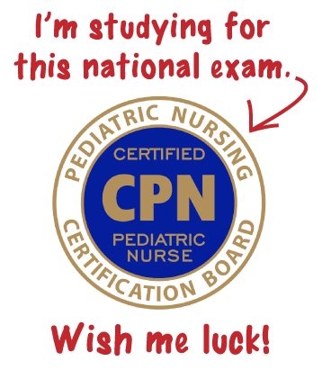
Create your plan
Now that you know about available resources, create a solid plan to support your success.
Set specific, measurable goals
Put study days on your calendar
Shorter, more frequent study periods may be more productive
Tell your family and friends… get them on board for babysitting or other support
Step away from the phone—minimize social media distractions
Tester Tip! Talk with a clinical educator if you need help creating or focusing your study plan.
Supporter Tip! Know a CPN who had an effective study plan? Ask them to share structure/ideas via PowerPoint or at informal meetings.

Slide 19

Make your goals….
Here are some examples:
I will brush up on topics in section 1.A. Physical Assessment of the exam content outline using a reference list textbook. I will allow at least 30 minutes per item. I will complete all these topics in my first 2 weeks of preparations.
For any weak areas on the content outline, I will seek out at least 1 recent CE activity from a respected source to increase my knowledge. I will also ask my educator for ideas to support this. I will complete each weak area within 1 week.
I will use a reference list textbook to review the first 5 procedures and interventions on the exam content outline. I have allotted 1 hour per item. I will complete this task within 1 week.

Slide 20
Does your employer offer No pass, No pay?
If so, it’s an awesome benefit they’re providing!
Before you apply, request the charge code from your site’s designated contact.
You use the code instead of up-front payment on the application.
If unsuccessful on the exam, you can use the code a second time during your employer’s current contract year.
  Max of 4 attempts with a code per nurse over time.
No-shows and cancellations count as a code use.
  If you can’t make your testing appointment, please cancel with Prometric.

Slide 21
don’t have access to No pass, No pay?
Ask educators or supervisors if your site is considering joining, or contact npnp@pncb.org to learn how employers join.
No cost for employers to participate.
No minimum number of RNs required to test per year.
Nurses use a code instead of up-front payment on the application.
If unsuccessful on the exam, RNs won’t be charged. Neither will your employer.
Learn about No Pass, No Pay and personalize this justification letter.

Slide 22

Before you apply
Are you ready to receive your 90-day testing window in just a few business days? PNCB processes applications very quickly.
Will you need Americans with Disabilities Accommodations (ADA)?
  If so, please indicate this on your application.
  Your healthcare provider will complete a form for you to submit to us.
  English as a second language is not covered under ADA.

Slide 23
Steps in APPLYING
Complete online application
Receive scheduling notification
Schedule exam with Prometric

Slide 24
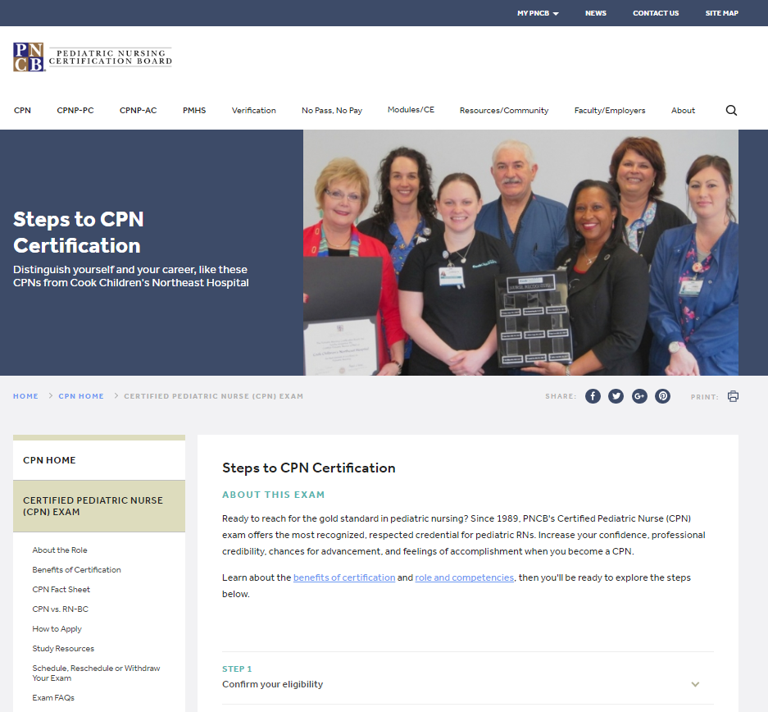
COMPLETE ONLINE APPLICATION
Go to www.pncb.org and…
Allow about 15 minutes to fill out the application.
Have your RN license info handy.
Attest to the eligibility and honor statement.
Type in demographic and contact info.
Submit payment unless using a No Pass, No Pay code.

Slide 25
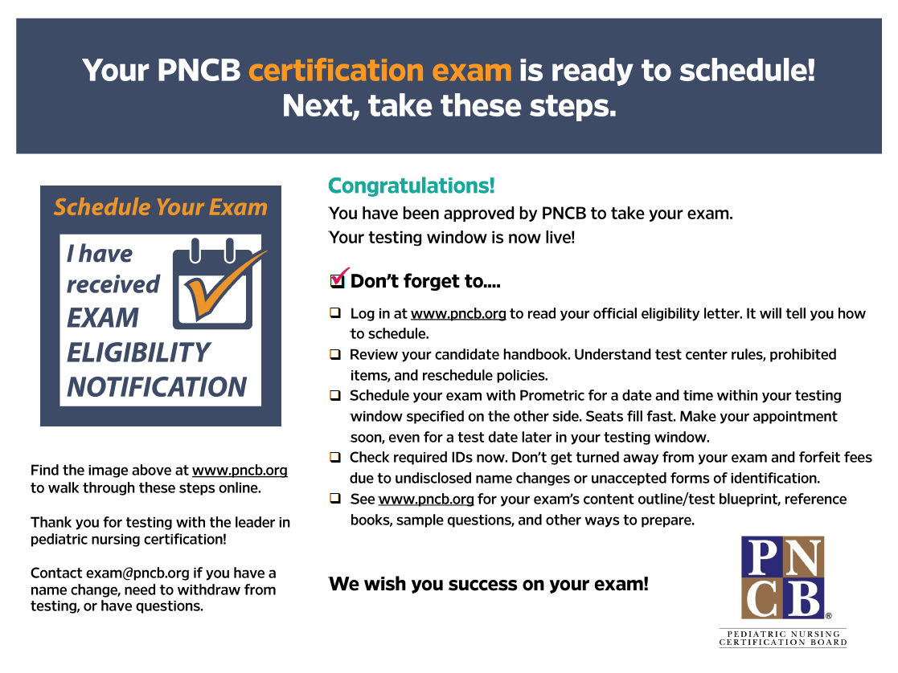
Receive Scheduling notification
Look for an email saying that your eligibility was approved.
  It will state your personalized 90-day testing window.
This is your green light to schedule your exam!

Slide 26

Schedule exam
Prometric Testing Centers will proctor your exam.
Schedule your exam using Prometric’s website or call them.
PNCB does not schedule on your behalf. If you need to change or cancel a test date, this is also managed by Prometric.
Prometric charges PNCB a fee whenever a tester doesn’t show, so please honor your scheduled appointment or formally cancel it.
Even if you plan to test later in the 90-day window, schedule soon after notification. Seats can fill quickly.
A 90-day extension is available for self-pay applicants. No Pass, No Pay applicants cannot order extensions.
Tester Tip! Check your IDs now. Make sure you have the forms of ID that we require. If you have any name changes before you test let us know right away. There’s a form you will need to fill out for PNCB.

Slide 27
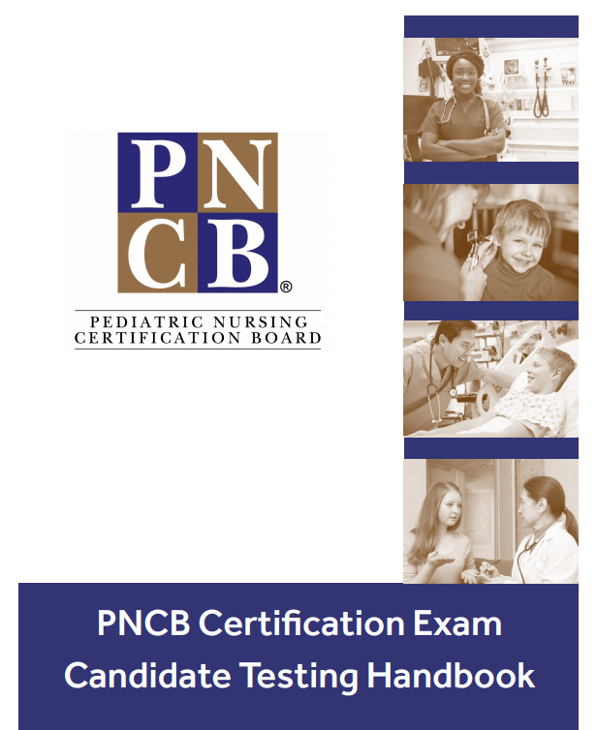
Please read your handbook
Don’t forfeit your exam fee or miss out on a use of your No Pass, No Pay code!
Read your testing handbook completely.
You’ll find the answers to these questions and many more:
Will I get a tutorial on the computer controls?
Can I take breaks?
Can I wear any jewelry?

Slide 28


More tips
Before exam day, go to your testing center on the same day and time as your appointment to check your commute timing.
View Prometric’s “What to Expect” slideshow.
  Some Prometric centers offer a 30-minute “Test Drive” for a fee to experience check-in and computer testing. Definitely optional, but can help you know what to expect.
On exam day:
  Arrive at least 30 minutes early.
  Bring required, unexpired IDs matching your name on your application.
  You will be scanned by a metal detector.

Slide 29
3. TEST
Things to know about the exam experience

Slide 30
How is the CPN EXAM different than the NCLEX?
PNCB exams are different than NCLEX in that our exam do not use adaptive testing, which can vary the number of questions a tester sees, and ends when competence is determined.
Your exam will only stop if you reach the end of the 3-hour testing period or if you finish and submit your answers for scoring.
PNCB's exams only ask multiple choice questions with one correct answer, while NCLEX contains alternative item formats (fill in the blanks, hot spot items, etc.).
With PNCB's exams, you can also return to questions and change an answer before final submission.

Slide 31
More FAQs
  Is there a penalty for incorrect answers?
  No, so it is better to answer every item rather than skip any.
  How is the exam scored?
  PNCB exams are criterion referenced. This means the passing score is based on predetermined criteria. Your ability to pass the exam depends on the knowledge you display, not on the performance of other candidates. PNCB uses a range from 200 (0 correct) to 800 (all correct) with 400 being the passing score.
  What is the passing rate?
  For 2017, the first-time pass rate was 78%.

Slide 32
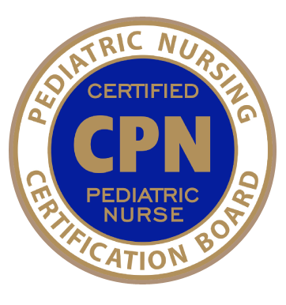
AFTER THE EXAM
You receive preliminary pass/fail status at the testing center.
Do not share specific recollections of exam questions with others afterwards.
If you pass:
Look for your wall certificate by mail in 2-3 weeks
Order your free lapel pin
Let your supervisor and others know
Ask if CPN can be added to your name badge

Slide 33
AFTER THE EXAM
If you were not successful:
Look for a results report in 2-3 weeks
There’s no waiting period to re-apply, but use your results to build a new strong study plan
Can I see which questions I got wrong?
No, because certification exams are secure, and important efforts are made to ensure that security, some of which you’ll notice at the testing center. This security is a requirement for exam accreditation.
While we understand that people want to learn from their mistakes, releasing questions (with or without answers) exposes exam questions that are still in use on exams.

Slide 34
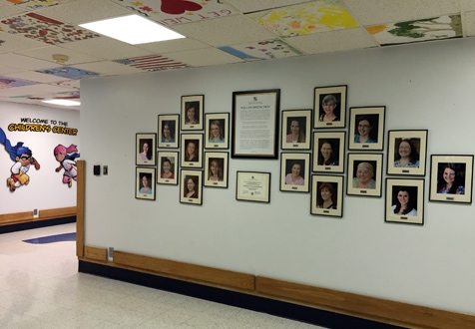
TIPS for supporting
When nurses get certified…
Celebrate them in newsletters and public spaces
Ask the CNO to send the nurse a letter
Ask physicians to host a break recognizing new CPNs
Send a press release to local papers
Send photos and stories to info@pncb.org for sharing on the PNCB website
Recognize CPNs at
  Certified Nurses Day: March 19
  Nurses Week: May 6 – 12
  Pediatric Nurses Week in October
CPN Wall of Distinction: The Children's Center at Tallahassee Memorial Healthcare

Slide 35
4. Stay Certified
Understand the renewal process to maintain CPN status

Slide 36

Maintaining certification
All certification boards require a renewal process.
Recertification or “Recert” for short is the process used to document that you’re keeping your practice and knowledge current.
CPNs recertify annually.
Fast online application
Keeps cost and requirements more manageable
Reduces time gathering CE certificates or other paperwork

Slide 37

What’s involved?
Complete 15 contacts hours (or equivalents that PNCB accepts) to document on the application.
Clinical practice/work hours are not required but can count toward the 15. Academic credit, research, teaching, and posters can be used too.
  See all options.
It doesn't matter to PNCB which options you document as long as the hours are:
  Already earned
  In the accepted date range
  Accredited (if true CE)
  Not a PALS etc. refresher
  Relevant to pediatric nursing or professional development in nursing

Slide 38
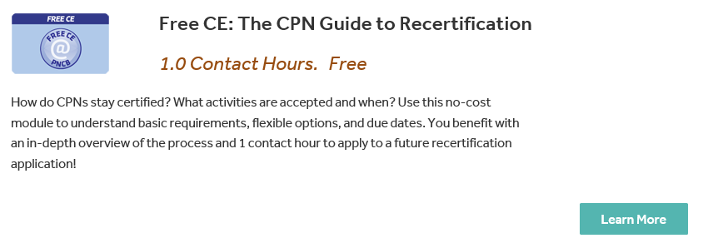
Learn & earn!
Use PNCB’s no-cost module to understand basic requirements, flexible options, and due dates.
Earn 1 contact hour to apply to a future Recert application for successful completion
Visit www.pncb.org to get this module.

Slide 39
Recert Timing
Submit the application between November 1 and January 31.
Avoid the late fee, which is added if you wait to recertify between February 1 and 28.
You choose the day between 11/1 and 1/31 to recertify each year.
Allow 15 minutes and know which 15 earned hours you want to document.
If you fail to recertify by the last day of February, your CPN certification will have lapsed. If there is an unforeseen critical life event that prevents you from recertifying timely, please contact our staff.
Did you pass the CPN exam in this calendar year? You won't need to recertify until the next calendar year.

Slide 40
Recert Tips
Does your employer offer No Pass, No Pay for the exam? Ask them if they offer it for Recert fees too.
You don’t lock in a specific date to recertify.
  If you recertify on 11/17 one year, you don’t have to recertify that day going forward. You are always in control of the date between 11/1 and 1/31.
Once every 7 years, you can use a reduced fee option called Record Review Year. You will still complete the application. No CE or other activities are required that year. Helpful for major life events!
You will see onscreen confirmation that your application and payment have been received. You also get an email confirmation immediately afterwards.

Slide 41

PNCB’s most important tip?

Slide 42

PNCB is here to Help!
Questions about any part of certification or Recert?
exam@pncb.org
recert@pncb.org
Need ideas to support interest in the exam?
Questions about No Pass, No Pay?
npnp@pncb.org
Or call us at 888-641-2767.
We wish you much success in testing!
PNCB staff members from the Customer Service Team

