Slide 1

2021-2022
Job Task Analysis for the
Certified Pediatric Nurse (CPN®) Exam
What is it, and why do it?

Slide 2
Purpose of the Study
The goals of this JTA were to develop updated test specifications and a detailed content outline for the CPN examination, and update the inventory of validated:
  tasks performed by pediatric nurses,
  clinical categories encountered, and
  procedures and interventions performed.

Slide 3
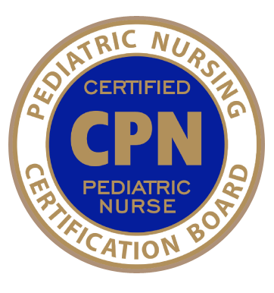
History and Purpose, cont.
The Job Task Analysis (JTA) uses a survey instrument to obtain descriptive information about the demographics and role responsibilities of pediatric nurses.
This periodic study is required of all nursing certification boards by their accrediting agency and involves soliciting input from those who hold the credential. Their responses validate what is most prevalent and/or most important in practice for the role.
In keeping with best practices, PNCB conducts JTA studies every 4 to 7 years; the process involves roughly 9 months of planned events and key processes.
(Learn more here).

Slide 4

History and Purpose, cont.
In order to develop a content outline for the certification examination, the JTA study identifies tasks, knowledge, skills, or abilities deemed to be important for pediatric nurses in a variety of settings who provide care to the pediatric population, newborns through young adults.
A task appears on the updated content outline only if it met validation criteria according to JTA study results.

Slide 5
What are the steps involved?
Over a period of several months between July 2021 and January 2022, the following occurred:
Development of the survey instrument with subject matter experts (SMEs) from around the country who hold the CPN credential. This involved:
Reflecting on trends in practice since the last study
Commenting on the current outline
Providing feedback or suggestions related to the delineation of practice
Pilot testing of the instrument for clarity and comprehensiveness.

Slide 6
What are the steps involved?
(cont.)
Dissemination of the survey to all actively-certified CPNs.
Analysis of survey data.
Development of test specifications and an updated content outline, using both survey findings and input from the subject matter expert task force.

Slide 7
The survey participants responded to these sections.
Survey Section | Rating
Screening | Yes/No
Tasks | Frequency and Importance
Domains | Percentage of Time and Importance & Percentage of CPN Examination
Sub-domains (when they existed) | Level of Importance & Percentage of Time Spent
Clinical Categories | Most and Least Encountered
Procedures and Interventions | Performance Frequency
Survey Comprehensiveness | Completeness of survey
Demographic/Professional Questions | Various Formats
Salary Questions | Various Formats
Eligibility Criteria Questions | Various Formats
In addition to the delineation of practice, questions were also included on the CPN eligibility criteria as well as a brief salary survey.

Slide 8
Results at a Glance
979 CPNs completed the survey
57% worked as a Direct Care RN
13% worked as a Charge Nurse / Assistant Manager
8% worked as a Nurse Manager / Coordinator
59% worked in Children’s Hospitals, and 16% in Outpatient Settings
For hospitals, this includes both free standing and hospitals associated with major medical centers.
591 spent more than 50% of their time in a nursing subspecialty
Of those, 16% were in Hematology/Oncology, followed by Critical Care (10%) and Perioperative (6%).
On average, respondents spent 77% of their time in direct patient care
Administration and supervisory activities were at 17%, followed by faculty / education at 4% and research at 2%.
Other Data
59% had > 10 years of pediatric experience
74% worked more than 30 hours per week.
66% are practicing in a suburban area.
Most survey participants indicated the role of the pediatric nurse providing services to children, adolescents, and young adults was adequately to completely covered.

Slide 9
Demographics of the CPN Over Time…
 | 2016-2017 | 2021-2022
Primary Practice Setting | Combined Medical/Surgical Unit 27.6% Intensive Care Unit 14.2% General Medical Unit 13.4% Subspecialty Unit 10.8% Perioperative 9.1% | Combined Medical/Surgical Unit 20.1% ↓ Intensive Care Unit 17.4% ↑ Subspecialty Unit 17.1% ↑ General Medical Unit 11.9% ↓ Other (e.g., ambulatory care, float pool) 9.1% ↑
Location of Practice Setting | Urban 68.7% Suburban 27.1% Rural 4.2% | Urban 66% ↓ Suburban 27% Rural 7% ↑
Highest Degree in Nursing | Bachelor of Science in Nursing 61.2% Master’s in Nursing 15.7% Associate's in Nursing Degree 15.3% | Bachelor of Science in Nursing 63.4% Master’s in Nursing 22.4%↑ Associate's in Nursing Degree 8.8%↓
Top 5 Conditions Seen (in order) | Respiratory Gastrointestinal Infectious Disease Emergency/Trauma/Poisoning Neurology | Respiratory Gastrointestinal/Nutritional Behavioral/Mental Health ↑ Infectious Disease ↓ Neurology
Top 5 States, by volume, where the Role is represented | Texas Ohio Pennsylvania California Florida | Texas Ohio California Pennsylvania Florida

Slide 10
Content Outline Impact
The description of the specialty was first reviewed, and minor updates were made to reflect current terminology. Once updated, this description served as an anchor for all subsequent work.
Of the 70 tasks surveyed, 69 met thresholds, were validated and/or were retained based on their high importance ratings from key subgroups, and thus, included on the final content outline.
Additionally, listings of clinical categories and procedures and interventions were also surveyed for validation and inclusion.
OVERALL

Slide 11
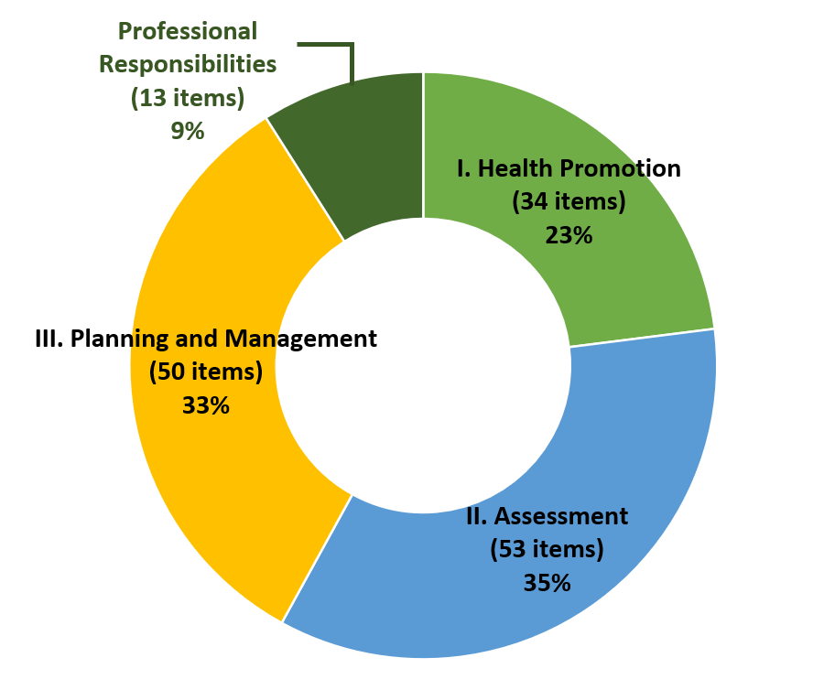
Content Outline Impact
The content domains – organized by Health Promotion, Assessment, Planning and Management, and Professional Responsibilities – have returned to a four (4) domain structure with Professional Responsibilities once again broken out as a standalone content category. Subtle refinements were made throughout the outline to the tasks.
DOMAINS
Allocations with the 2016-2017 study were Domain 1 Assessment (38%); Domain 2 Health Promotion (14%); Domain 3 Management (48%). Professional Responsibilities had been included within the Management domain on the 2016-2017 outline.

Slide 12
Content Outline Impact
By Structure
2017 Domain Structure | 2022 Domain Structure
Assessment Physical Psychosocial Health Promotion Management Acute and Chronic Illness Psychosocial/Behavioral Palliative and End of Life Care Professional Responsibilities | Health Promotion Assessment Physical Psychosocial Planning and Management Acute and Chronic Care for Physical and Behavioral Health Needs Psychosocial and Child/Family-centered Care Palliative and End of Life Care Professional Responsibilities Acute and Chronic Illness Psychosocial/Behavioral Palliative and End of Life Care Professional Responsibilities
DOMAINS

Slide 13
Content Outline Impact
By % of Items, # of Items per Domain
2017 Domain Structure | 2022 Domain Structure
Assessment 38% (57 items) Health Promotion 14% (21 items) Management 48% (72 items) | Health Promotion 23% (34 items) Assessment 35% (53 items) Planning and Management 33% (50 items) Professional Responsibilities 9% (13 items)
= 150 items | = 150 items
DOMAINS

Slide 14
Content Outline Impact
All current tasks in the CPN detailed content outline were retained either as-previously-written or with minor editorial updates.
Added tasks include:
  Health Promotion
    Building resilience and healthy coping
  Assessment
    Assess the child’s environments (e.g., home, school, health care setting) for developmental, cognitive, and physical needs
    Assess impacts of adverse childhood experiences (ACEs) (e.g., death of caregiver, divorce, abuse) and social determinants of health (e.g., socio-economic status, displacement, racial inequalities)
TASKS

Slide 15
Content Outline Impact
Added tasks include (continued):
  Planning and Management
    Collaborate with members of the child’s health care team to contribute to an accurate medical diagnosis
    Integrate trauma-informed care principles (e.g., safety, trustworthiness and transparency, choice) into care planning and management
  Professional Responsibilities
    Advocate at the system and governmental levels for policies that support children and families (e.g., patient ratios, access to care, resources)
    Engage in interdisciplinary collaboration to provide comprehensive care
TASKS

Slide 16
Content Outline Impact
CLINICAL CATEGORIES
1 | Respiratory
2 | Gastrointestinal/Nutritional
3 | Behavioral/Mental Health
4 | Infectious Disease
5 | Neurology
6 | Eye, Ear, Nose and Throat
7 | Endocrine/Metabolic
8 | Musculoskeletal
9 | Trauma
10 | Hematology/Oncology
11 | Emergencies/Poisoning/Overdose
12 | Cardiovascular
13 | Genitourinary/Renal/Reproductive
14 | Skin/Wound/Burns
15 | Child Maltreatment and Neglect
16 | Allergy/Immunology/Rheumatology
Respiratory, Gastrointestinal (Nutritional), Infectious Disease, and Neurology remained among the most frequently seen diagnoses.
Behavioral / Mental Health jumped from previous rank of 13, to rank 3.
Trauma is now a standalone clinical category (at rank 9) where before, it was combined with Emergencies/Poisoning.
Allergy / Immunology / Rheumatology (at rank 16) now includes Rheumatology where it previously did not.
Previously named “Clinical Problems”, the listing of Clinical Categories retained 16 of the 18 which were surveyed. Survey respondents were asked to rank their MOST frequently seen, and LEAST frequently seen. The order shown here represents the specific condition, by volume, represented on the exam.

Slide 17
Content Outline Impact
PROCEDURES AND INTERVENTIONS
Exam content will include a focus on the following procedures and interventions (listed alphabetically).
Body temperature regulation
Fluid and electrolytes administration
Infection prevention and use of PPE NEW
Line and tube maintenance: Drainage devices (e.g., surgical, urinary, neurological)
Line and tube maintenance: Enteral tubes
Line and tube maintenance: Respiratory devices (e.g., tracheostomy, chest tube, O₂ delivery)
Line and tube maintenance: Vascular access devices
Medication administration
Nutrition support (e.g., therapeutic diets, oral hydration, tube feeding)
Physiological monitoring (e.g., ECG, pulse oximetry, ETCO2)
Positioning (e.g., procedures, developmental, devices, therapeutic)
Preventative safety measures (e.g., safe sleep, seizure precautions, fall prevention) Previously titled “Implement safety precautions”
Skin and wound care
Specimen collection and point of care testing
Suctioning
Nineteen (19) procedures and interventions were surveyed in the instrument asking respondents how frequently they had performed each in the past 12 months, from never to daily. Fifteen (15) met validation through a 5-point frequency scale.
Blood product administration, phototherapy, procedural sedation, and restrictive interventions did not meet the threshold and are no longer listed.

Slide 18
Exam Details
There were no changes in the number of questions
  150 scored items and 25 unscored items
  A candidate will not be able to distinguish between scored and non-scored questions.
There was no change in time allotment
  3.0 hours

Slide 19
FAQs
Q: When does the updated exam launch?
  A: New exam forms tied to the 2022 outline are expected to launch in October 2022. See PNCB’s website for specific dates and other details.
Q: Have the eligibility requirements changed as a result of this study?
  A: No, eligibility requirements have remained the same.
Q: Is there an advantage in taking one version of the exam over the other?
  A: No, both will equally assess your knowledge.

Slide 20
FAQs
Q: Will the updated outline include questions about COVID?
  A: While COVID is an extremely prevalent and important topic, national guidelines or recommendations regarding COVID may change more frequently than other foundational information or topics within the infectious disease clinical conditions category. JTA research did ask practicing CPNs the impact COVID has had on their everyday practice but did not collect data on frequency- or management- of the condition. There would only be an item about this disease on the CPN exam if it can be supported by a textbook reference or national consensus guideline.
Q: Do I need to study differently with this updated outline?
  A: No, the reference list remains the same because the tasks listed on the new outline have not changed significantly from the previous outline.

Slide 21

If you have questions, please visit:
www.pncb.org or email exam@pncb.org.
Our team will be glad to assist.
We wish you much success on your upcoming exam.
Created 05 2022

