Slide 1
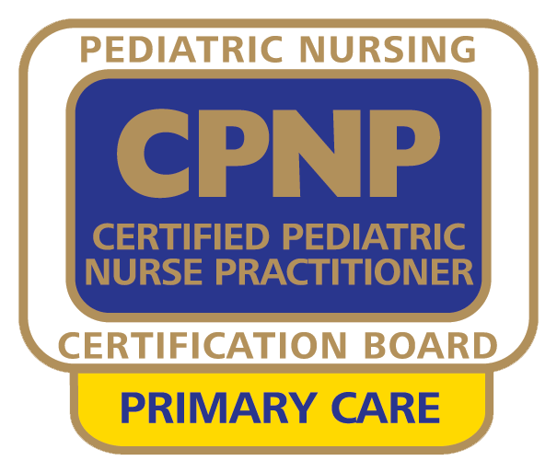
2017-2018 Job Task Analysis for the Certified Pediatric Nurse Practitioner – Primary Care (CPNP-PC®) Exam
What is it, and why do it?

Slide 2
2017-18 JTA for the CPNP-PC Exam
The purpose of the Job Task Analysis (JTA) is to:
update and validate the inventory of tasks performed by primary care pediatric nurse practitioners;
update inventories of clinical problems seen and procedures performed in practice; and
develop new test specifications and a detailed content outline for the CPNP-PC exam.

Slide 3
2017-18 JTA for the CPNP-PC Exam
The JTA uses a survey instrument to obtain descriptive information on demographics and role responsibilities of primary care pediatric nurse practitioners.
This periodic study is required of all nursing certification boards by their accrediting agency.
In keeping with best practices, PNCB conducts JTA studies every 4 to 7 years.

Slide 4
2017-18 JTA for the CPNP-PC Exam
In order to develop a content outline for the certification examination, the JTA study identifies tasks, knowledge, skills, or abilities deemed important to practice by primary care pediatric nurse practitioners.
A task appears on the updated content outline only if it met validation criteria according to JTA study results.

Slide 5
2017-18 CPNP-PC Job Task Analysis
Steps Involved & Results “at a glance”...

Slide 6
2017-18 JTA for the CPNP-PC Exam: Steps Involved
Over a period of several months, the following occurred:
Development of the survey instrument with subject matter experts (SMEs) from around the country
Pilot testing of the instrument for clarity and comprehensiveness
Dissemination of the survey
Analysis of survey data
Development of test specifications and the updated content outline from survey findings with input from the SMEs

Slide 7
2017-18 JTA for the CPNP-PC Exam: Survey Overview
The survey participants responded to the following survey sections:
Tasks
Domains
Clinical Problems
Procedures
Evaluation of Survey Comprehensiveness
Demographic and Professional Questions
Exploration of Continuing Competence and Career Advancement

Slide 8
2017-18 JTA for the CPNP-PC Exam: Results “at a glance”…
A total of 1,509 primary care pediatric nurse practitioners completed the survey. This exceeded responses on prior JTA surveys, and met the industry standard for validation.
Location of practice setting: 46% of respondents worked in urban areas.
Primary employment setting: just over 50% worked in ambulatory care in the community
Years of experience: 50% of respondents had more than 10 years of PNP experience.
The majority of respondents (52%) spent 31-40 hours per week in clinical practice as a PNP.
One-third of respondents indicated they spent more than 50% of their time in a pediatric nursing subspecialty.

Slide 9
2017-18 JTA for the CPNP-PC Exam: Over time…
 | 2012-13 | 2017-18
Location & Type of Practice Settings | 44% practice in urban settings 48% practice in primary care outpatient 81% time spent in direct patient care | 46% practice in an urban setting 50% practice in ambulatory care in the community 85.7% time spent in direct patient care
Prescriptive Privileges | 95% Yes, I can prescribe 5% No, I cannot prescribe | 98% Yes, I can prescribe > 62.6% Full: Schedules II – V > 26.6% Partial: Cannot prescribe Schedule II > 8.8% Partial: Limited other Schedules (not II) 2% No, I cannot prescribe
Top 5 Conditions Seen (in order) | Eyes / Ears / Nose / Throat (EENT) Respiratory Gastrointestinal Dermatology Behavioral / Psychological | Head, Eye, Ear, Nose, and Throat (HEENT) Dermatology Allergy Gastroenterology Developmental / Behavioral / Mental Health

Slide 10
2017-18 JTA for the CPNP-PC Exam: Results “at a glance”…
The large majority of TASKS were validated as current and retained in the new outline.
Changes include:
Removed 4 tasks in IV Professional Roles and Responsibilities
Collapsed or combined task examples:
III.A.1 provide condition-specific counseling and education, including treatment options
III.B.5. utilize communication techniques and brief cognitive interventions, including motivational interviewing and joint decision-making, to develop health care goals and facilitate change

Slide 11
How the new study impacted the exam... Content Outline Changes from 2011 to 2017
2017-18 CPNP-PC Job Task Analysis

Slide 12
2017-18 JTA for the CPNP-PC Exam: How the new study impacted the exam…
The larger content structure with 4 domains remained the same, with some wording clarifications; subdomains were rearranged slightly to accommodate re-worded tasks, or new/combined tasks. Item counts also remained the same in the large domains.
 | 2012-13 | 2017-18
% of items, # of items per domain | Health Promotion 30% (45 items) Assessment & Diagnosis 35% (52 items) Management 30% (45 items) Professional Issues 5% (8 items) | Health Maintenance & Promotion 30% (45 items) Assessment & Diagnosis 35% (52 items) Management 30% (45 items) Professional Role & Responsibilities 5% (8 items)
 | Total = 150 | Total = 150

Slide 13
2017-18 JTA for the CPNP-PC Exam: How the new study impacted the exam…
PROCEDURES are no longer included as formal “tasks” within a domain, but remain as additional detail for exam item writing and preparation.
All existing procedures were maintained:
Audiometry
Cerumen removal
Fluorescein staining
Incision and drainage
Rapid tests
Reduction of nurse maid’s elbow
Removal of foreign body
Removal of sutures and staples
Visual acuity
Additional procedures validated by the data and added:
Collect skin and body fluid specimens
Spirometry/pulmonary function test
STI testing
Wart removal
Umbilical cord cauterization

Slide 14
2017-18 JTA for the CPNP-PC Exam:
How the new study impacted the exam…
There were no changes in the number of questions
150 scored items and 25 pre-test items
There was no change in time allotment
3 hours

Slide 15
Answers to Frequently Asked Questions
2017-18 CPNP-PC Job Task Analysis

Slide 16
2016-17 JTA for the CPNP-PC Exam: FAQs
Q: When does the updated exam launch?
A: New exam forms tied to the 2018 outline are expected to launch in September 2018. See PNCB’s website for specific dates and other details.
Q: Is there any advantage in taking one version of the exam over the other?
A: No, both will equally assess your knowledge.
Q: Do I need to study differently if I choose to take the new exam?
A: No, any preparations undertaken will benefit you regardless of which exam you take. The reference list remains the same because the tasks listed on the updated outline have not changed significantly from the previous one.

Slide 17
2016-17 JTA for the CPNP-PC Exam: FAQs
Q: Have the eligibility requirements changed as a result of this study?
A: No. Eligibility requirements have remained the same.
Q: Where can I confirm my eligibility?
A: Visit PNCB’s website for more information: https://www.pncb.org/cpnp-pc-certification-steps

Slide 18
2016-17 CPNP-PC Job Task Analysis
If you have questions: please visit www.pncb.org
or email exam@pncb.org
We will be glad to help!
We wish you much success on your upcoming exam.
Updated 08242021

