Slide 1
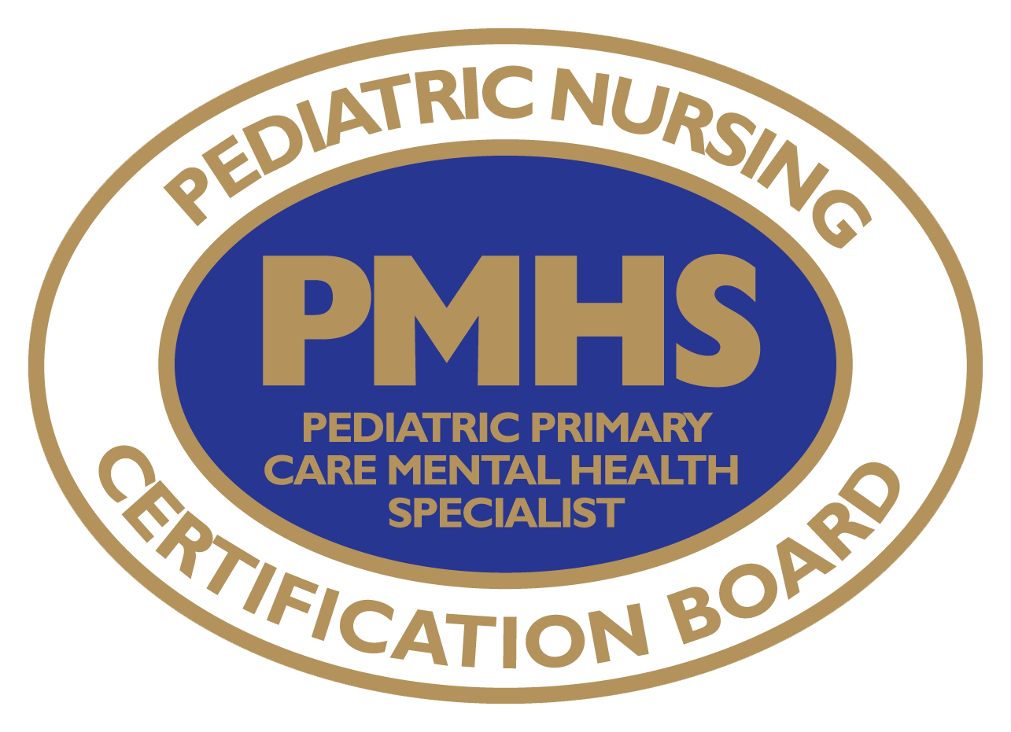
2016-2017 Job Task Analysis for the Pediatric Primary Care
Mental Health Specialist (PMHS®) Exam
What is it, and why do it?

Slide 2
2016-17 JTA for the PMHS Exam
The purpose of the Job Task Analysis (JTA) study is to:
  validate the inventory of tasks and knowledge related to work performed by the role;
  ensure that the task and knowledge statements identified are congruent with the objective of certifying PMHSs; and,
  develop test specifications for the PMHS examination.

Slide 3
2016-17 JTA for the PMHS Exam
The Job Task Analysis (JTA), uses a survey instrument to obtain descriptive information on demographics and responsibilities of a role.
In order to maintain or receive accreditation for an exam, accrediting agencies require this periodic study.
In keeping with best practices, PNCB conducts JTA studies typically every 4-5 years—for the PMHS credential, this was the second-ever JTA completed.
In order to develop a content outline for the certification exam, the JTA study identifies tasks, knowledge, skills, or abilities deemed important to practice.

Slide 4
2016-17 PMHS
Job Task Analysis
Steps Involved & Results “at a glance”...

Slide 5
2016-17 JTA for the PMHS Exam:
Steps Involved
Over a period of several months, the following occurred:
  Development of the survey instrument with subject matter experts (SMEs) from around the country
  Pilot testing of the instrument for clarity and comprehensiveness
  Dissemination of the survey
  Analysis of survey data
  Development of test specifications and the updated content outline from survey findings and input from the SMEs

Slide 6
2016-17 JTA for the PMHS Exam:
Survey Overview
The survey participants responded to the following survey sections:
  Tasks
  Domains
  Diagnoses
  Psychosocial/Environmental Conditions
  Pharmacological Interventions
  Non-pharmacological Interventions
  Screening and Assessment Tools
  Evaluation of Survey Comprehensiveness
  Demographic Questions
  Evaluation of PMHS Eligibility Criteria

Slide 7
2016-17 JTA for the PMHS Exam:
Results “at a glance”…
A total of 293 APRNs completed the survey
  39% of the entire PMHS-certified population (at the time) participated
55% of respondents worked in Primary Care settings
12% worked in Developmental/Behavioral Pediatrics
On average, respondents spent 79% of their time in direct, clinical practice
70% of respondents prescribe Schedule II medications
The most commonly earned degree was the Master’s degree, held by 80% of respondents
97% of respondents indicated that the survey covered the role and tasks of the PMHS adequately to very well.

Slide 8
2016-17 JTA for the PMHS Exam:
Over time…
 | 2009-10 | 2016-17
Practice Setting | Clinic – Primary Care 30.6% Clinic – Subspecialty 28% Private Practice – Primary Care 19.4% Private Practice – Subspecialty 7.1% School-based Health 6% | Primary Care Clinics (Peds, Family Practice, Adolescent) 55.2% Developmental/Behavioral Pediatrics Clinics 12.2% Pediatric Outpatient Clinic or Specialty Practice 11.5% Psychiatry Outpatient Clinic or Specialty Practice 11.5%
Location of Practice Setting | Urban 49.3% Suburban 34% Rural 16.8% | Urban 45.7% Suburban 41.7% Rural 12.6%
Top 5 Referrals to Other Services | Counselor/Therapist 90.4% Child/adolescent psychiatrist 88.5% Neurologist 79.6% OT/PT/Speech 78.8% Pediatric psychologist 65.9% | Counselor/Therapist 89% Child/adolescent psychiatrist 82.5% OT/PT/Speech 78.8% Neurologist 69.9% Pediatric psychologist 69.2%

Slide 9
2016-17 JTA for the PMHS Exam:
Results “at a glance”…
Overall, the description of the role was expanded throughout to more clearly reflect a specialty expertise in pediatric developmental, behavioral and mental health (DBMH) problems.
All tasks (77) that were surveyed met criteria.
Added tasks include:
  Promoting optimal developmental progression
  Providing education about the connection between physical, spiritual, environmental, and psychological determinants of health
  Counseling around environmental accommodations and adaptations
  Administering evidence-based DBMH assessment tools

Slide 10
2016-17 JTA for the PMHS Exam:
Results “at a glance”…
Diagnoses and interventions now appear in prioritized order based on the survey ratings.
  Prioritized order is based on the frequency with which these items are seen or used in practice.
New! A prioritized list of the most frequently-used screening and assessment tools has been added.

Slide 11
2016-17 PMHS
Job Task Analysis
How the new study impacted the exam...
Content Outline Changes from 2011 to 2017

Slide 12
2016-17 JTA for the PMHS Exam:
How the new study impacted the exam…
Developmental, Behavioral and Mental Health (DBMH) Promotion now stands alone as a content domain.
The Evaluation domain separates the prior Domain II and gives emphasis to history-gathering, and use of screening tools.
2011 Domain Structure | 2017 Domain Structure
Mental Health Assessment and Promotion Diagnostic Decision Making Management Professional Issues | Developmental, Behavioral and Mental Health Promotion Evaluation Diagnostic Decision Making Management Professional Role

Slide 13
2016-17 JTA for the PMHS Exam:
How the new study impacted the exam…
 | 2009-10 | 2016-17
% of items, per domain | Mental Health Assessment and Promotion (40%) Diagnostic Decision Making (27%) Management (30%) Professional Issues (3%) | Developmental, Behavioral and Mental Health Promotion (25%) Evaluation (23%) Diagnostic Decision Making (23%) Management (24%) Professional Role (5%)
# of items, per domain | Mental Health Assessment and Promotion (50 items) Diagnostic Decision Making (34 items) Management (37 items) Professional Issues (4 items) | Developmental, Behavioral and Mental Health Promotion (31 items) Evaluation (29 items) Diagnostic Decision Making (29 items) Management (30 items) Professional Role (6 items)

Slide 14
2016-17 JTA for the PMHS Exam:
How the new study impacted the exam…
Diagnoses – 30 diagnoses were sorted in descending order of priority.
  Sorting was based on the percentage of respondents indicating that 26% or more of their patients presented with the diagnosis.
Screening and Assessment Tools – 12 of the 43 tools met the threshold for inclusion.
  Sorted in descending order by priority. Sort order sort was based on the percentage of respondents administering the tool.

Slide 15
2016-17 JTA for the PMHS Exam:
How the new study impacted the exam…
Pharmacological Interventions – All 11 categories of pharmacological agents were viable topics for exam questions. For the new content outline, they are
  Sorted in descending order by priority. Sort order was based on the percentage of respondents prescribing the medication.
Non-pharmacological Interventions – 6 of the 23 of the non-pharmacological interventions met criteria based on 25% or more of respondents performing the intervention.
  These 6 non-pharmacological interventions were sorted in descending order by priority. Sort order was based on the percentage of respondents performing the intervention.

Slide 16
2016-17 JTA for the PMHS Exam:
How the new study impacted the exam…
There were no changes in the number of questions
  125 scored items and 25 pre-test items
There was no change in time allotment
  2.5 hours

Slide 17
2016-17 PMHS
Job Task Analysis
Answers to Frequently Asked Questions

Slide 18
2016-17 JTA for the PMHS Exam:
FAQs
Q: When does the updated exam launch?
  A: The new exam is expected to launch with the testing window that begins November 1, 2017.
Q: Is there any advantage in taking one version of the exam over the other?
  A: No, both will equally assess your knowledge.
Q: Do I need to study differently if I choose to take the new exam?
  A: No, any preparations undertaken will benefit you regardless of which exam version is administered. The reference list remains the same because the tasks listed on the new outline have not changed significantly from the older one.

Slide 19

2016-17 JTA for the PMHS Exam:
FAQs
Q: Are the eligibility requirements changing?
  A: Yes, this JTA provided an opportunity to get broad stakeholder input about eligibility criteria for this added-specialty APRN exam.
Q: When do the eligibility changes take effect?
  Beginning November 2017: Select APRNs, who are currently licensed, nationally board certified, and who graduated prior to the 1992 PNCB Board requirement to be Master’s prepared in the population for which they are certified, are now eligible for the PMHS exam.
  Beginning May 2018: Updated, required eligibility criteria here will include:
    Attestation to clinical practice hours
    Education: One (1) graduate level DBMH course of at least 2 credits OR 30 hours of DBMH CE in the last 3 years.
    Check PNCB’s website for more information, https://www.pncb.org/pmhs-exam-eligibility

Slide 20
2016-17 PMHS
Job Task Analysis
If you have questions:
please visit
www.pncb.org
or email
exam@pncb.org
We will be glad to help!
We wish you much success on your upcoming exam.

