Slide 1

Test-Taking Strategies
Dealing with Test
Anxiety
+
Tips for
Multiple-Choice
Exam Questions

Slide 2
Objectives
At the completion of this resource, the participant will be able to:
identify strategies for managing test anxiety
personally prepare to take a high-stakes exam
determine strategies for answering multiple choice test items

Slide 3

1. DEALING WITH TEST ANXIETY

Slide 4

What is Test Anxiety?
A complex phenomenon
Includes physical, mental, and behavioral responses related to fear of negative consequences
May feel as if the test is a personal threat, inducing fight or flight responses
May occur before, during, or after a test
Tends to come in a wave

Slide 5

More about Test Anxiety
The degree of anxiety varies along a continuum from mild preoccupation to a fear of failure and sense of worthlessness

Slide 6

Responses to Anxiety
Physical:
↑ Heart Rate, ↑ Respirations
Muscle Tension
Sweating
Mental:
Nervousness, uneasiness
Negative thoughts
Drawing a “blank”
Behavioral:
Pacing
Foot tapping
Avoidance

Slide 7
Factors Related to Test Anxiety
Variety of factors
  - Content - Difficulty of test
  - Time pressures - Lack of preparation
  - Setting - Method of administration
  - Previous experience - Life situation
Test anxiety INCREASES with:
  - Increased importance
  - Increased likelihood of failing
  - Test proximity
  - Feeling more unprepared

Slide 8
What Can You Do About Test Anxiety?
Identify factors related to your test anxiety.
Identify how anxiety affects you.
Identify when anxiety tends to occur.
Learn strategies to manage the test anxiety.
Practice and use the strategies.

Slide 9
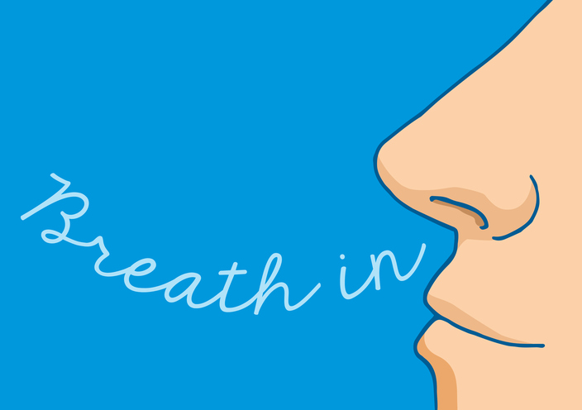
Techniques to Reduce Test Anxiety
Deep or Controlled Breathing

Slide 10
Deep Breathing Exercise
Sit comfortably and close your eyes
Slowly take a deep breath…Hold for a count of 4
Now slowly exhale through the mouth for a count of 8
As you inhale, say to yourself: I AM…
As you exhale, say to yourself: RELAXED
Repeat:
Slowly inhale, hold for a count of 4, and say : I AM…
RELAXED as you exhale for a count of 8
If your mind wanders, come back to the awareness of your breathing and to the words: I AM…RELAXED
When you are ready to stop, slowly open your eyes

Slide 11

Techniques to Reduce Test Anxiety
Progressive Muscle Relaxation

Slide 12

Progressive Muscle Relaxation
Sit or lie down comfortably, allowing chair or floor to support you
Close your eyes
As you inhale, tighten muscles in toes and hold for 5 to 10 seconds
As you exhale, suddenly and completely relax toes and remain relaxed for 5-10 seconds (do not relax gradually)
Flex muscles in feet
  Hold for count of 10
  Relax feet
Flex muscles in legs
  Hold for count of 10
  Relax legs
Slowly move up through your body, progressively flexing and relaxing muscle groups as you go: abdomen…back…neck…face
After you have tensed and relaxed each part of the body, take a couple of deep, slow breaths
Slowly stretch your hands and feet, then your arms and legs, finally stretch your whole body
Slowly open your eyes

Slide 13

Techniques to Reduce Test Anxiety
Guided Imagery

Slide 14

Guided Imagery
Close your eyes and visualize a peaceful, relaxing time or place.
What do you see?
What do you hear?
What are the smells?
Remember how you felt in that place — relaxed and peaceful.

Slide 15

Techniques to Reduce Test Anxiety
Desensitization
Describe your anxiety and the feelings it causes, or write down one thing that causes you to be anxious.
Use a relaxation exercise.
While relaxed, visualize what is causing the anxiety.
Repeat several times until visualizing it no longer creates the same anxiety.

Slide 16

Techniques to Reduce Test Anxiety
Think and Talk Positively
Visualize a positive outcome.
Replace negative thoughts with positive.
I’m going to fail this test.
I have the ability to do well on this test!

Slide 17
Think and Talk Positively
I’ll never be able to answer all the items correctly.
If I fail this test, I won’t be able to face my family and friends.
I’m so slow, I’ll never have enough time to finish the test.
No one is expected to answer all the items correctly.
If I fail this test, my family and friends will still love me.
I'll pace myself and have plenty of time to finish the test.

Slide 18

Techniques to Reduce Test Anxiety
Regular Moderate Exercise
At least 20 minutes 3 times/week
Improves sleep
Expends nervous energy

Slide 19

Techniques to Reduce Test Anxiety
Prepare! Prepare! Prepare!
Establish a study schedule (in writing!)
  Put days & times on your calendar
  Use shorter, more frequent periods
  Build in extra days at the end
Set goals
  Identify your strengths and weaknesses
  Put goals in writing
  Use SMART goals
  Specific, Measurable, Attainable, Realistic/Relevant, Time-bound

Slide 20

Get Support
Identify people who can help you
  Find other applicants wanting to form a study group. Choose positive colleagues focused on strategies, not worrying.
  Find a mentor at work who has passed the exam and is willing to share study plan ideas.
    [Note: persons who have taken the exam have signed an agreement that they will not discuss content of exam questions. ]
  If you have access to a clinical education department, be sure to check their resources.
  Connect with your local Society of Pediatric Nurses (SPN) or National Association of Pediatric Nurse Practitioners (NAPNAP) chapter for possible mentors.
  Ask family members for babysitting and other help.
  Give yourself permission to say ‘no’ when others make demands on your time.
  Explore taking some time off or asking for other support from a work supervisor.

Slide 21


Establish Boundaries
Have a specific, quiet place to study.
Make quiet study time a reality.
  Get family members and friends on board to support your goals and respect study time.
  Bring only the study items you need.
  Resist the urge to use the Internet or pick up your smart phone frequently. Turn your phone off if you can. Take a break from social media.
  Consider an Internet blocking app during study time.
Notes:
On iStock board. Symbol added.

Slide 22
Exam Content Outline
Print the content outline/test blueprint for your exam from www.pncb.org.
This document shows what content you’ll be tested on.
  This is your #1 tool to start your study plan!
  Read it line-by-line and identify weak areas.
  Find textbook content on your weak areas. Your exam’s recommended reference list is posted at www.pncb.org.
  Questions will not simply include knowledge recall. The exam tests your ability to apply knowledge and use critical thinking skills to determine one best answer.

Slide 23

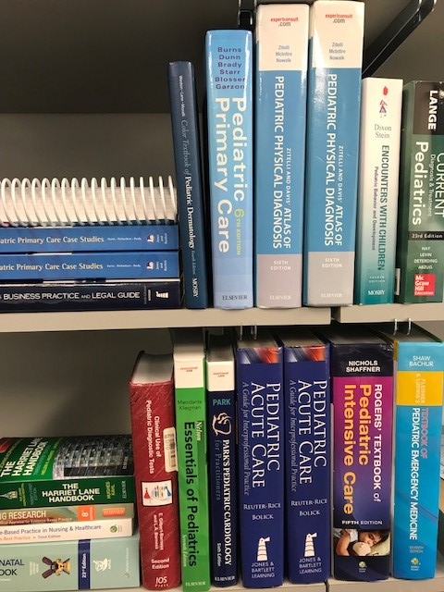
Reference List
Review your exam’s recommended reference list at www.pncb.org.
Pick 1 familiar textbook that focuses on the subject areas covered by your exam’s content outline.
  Are suggested reference books in your hospital or employer’s library?
  Are texts in your personal library up to date?
  Can you use the local library or a colleague’s texts?

Slide 24

Learner Types
Also think about what type of learner you are:
Visual | highlight or diagram material
Verbal | use speech and writing to learn
Auditory | tape record notes, study with a group
Interpersonal | study with a group, use discussion to enhance learning
Intrapersonal | prefer self-study
Kinesthetic | move as you study, associate movement with content as a memory technique

Slide 25
Notes and Study Materials
The type of learner that you are will determine the kinds of study aides you will use! Some examples are listed below:
Create study index cards which include information based on the content outline.
Write test questions on index cards which contain answers on the back.
Use class notes if available, including PowerPoint presentations and outlines.
Categorize your notes by body system or disease entity.
Prepare a file of clinical practice guidelines, pediatric nursing techniques, or highlights of growth and development.
A study group exchange test questions they have written themselves.
Practice taking test questions from as many sources as possible.

Slide 26
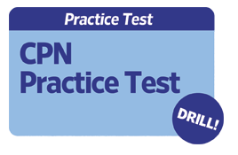
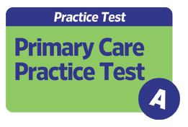
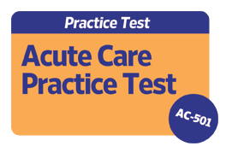
Practice Questions
PNCB offers optional practice modules for personal use.
While not required, our practice modules present questions written by subject matter experts who hold your desired credential.
Practice tests share in-depth rationale for correct answers. Note that our CPN 100-question drill provides correct answers only without explanations.

Slide 27

Snacking Tips
Make healthy snack choices while studying
  choose veggies and fruits
  limit caffeine
  avoid chips, alcohol, energy drinks, and foods high in sodium

Slide 28



A Few Days Before the Test:
The Test Center:
Take a practice drive to the testing center on the same day of the week and time of day as your scheduled exam.
Find your accepted IDs and put them in a safe place to carry with you.
If the center is at some distance, consider staying at a hotel the night before.
Life Preparations:
Do not plan to work immediately before your scheduled test.
Plan a date to conclude your study plans.
Schedule relaxing activities a few days prior to the test date.
If unforeseen life events occur, reschedule your exam!

Slide 29


    the day of the test

Slide 30


Practical Reminders
Limit caffeine, avoid energy drinks
Get a good night’s sleep
Dress comfortably and in layers
Eat a light, nutritious meal
Arrive early
Have everything you need
Visit the restroom before the test
Think positively!

Slide 31
Listen to Instructions Carefully
The following information applies to PNCB examinations!
Check PNCB’s Candidate Testing Handbook for FAQs.
How many exam questions
What items can I bring with me?
How much time do I have?
Are breaks allowed?
Can I use scratch paper?
Can I skip questions and return?
Is there a penalty for wrong answers?

Slide 32
Computer-based Testing
Administration uses standardized screens and technology
A tutorial is offered and does not count against exam time or score
Only one question appears on-screen at a time
A Time feature helps you monitor remaining time (optional)
Skipping a question and returning is allowed
You may change an answer as often as you wish
Review your candidate handbook for details

Slide 33

Manage Your Time
How much time & how many items Time/Item
  For multiple choice: 1 minute per item
PNCB exams do not have sections, but if you plan to take an exam that does:
  Estimate time per section
  Allot more time to sections that count for more points.
Use all the time you are given
Don’t worry if others finish early

Slide 34

Anxiety During the Exam
Use a short version of relaxation
Visualize
Take 2 minutes for deep breathing
Stretch muscles
Use positive statements

Slide 35
Breaks During the Exam
For PNCB computer-based exams:
Total testing time allows for short breaks.
You may take a break whenever you wish, but no additional time is allowed to make up for time lost during breaks.

Slide 36

3.strategies for answering Multiple choice items

Slide 37
Terminology
STEM = The test question and information to answer the question.
There are 2 types of stems:
Question stem | By how many months of age should a child develop a fine pincer grasp?
Incomplete sentence stem | A child should develop a fine pincer grasp by ____ months of age.

Slide 38
Terminology
OPTIONS = Possible answer choices.
One is the best or correct answer
The rest are plausible distractors.
  Example:
  A. 6 (distractor)
  B. 12 (correct answer)
  C. 18 (distractor)
  D. 24 (distractor)

Slide 39
Types of Items
Recall of knowledge item
  Asks for a memorized fact
  Has only one correct answer
  Note that knowledge recall is not the focus of PNCB exams
Application/analysis item
  Asks you to use or apply a fact
  Tests at a higher cognitive level
  Has one best answer
  PNCB exams use these types
What is the FIRST step in resuscitation?
begin chest compressions
check patient’s pulse
check patient’s breathing
ensure airway is open
An infant being evaluated for respiratory distress suddenly stops breathing. What is the PRIORITY intervention?
begin chest compressions
check patient’s pulse
check patient’s breathing
ensure airway is open

Slide 40
Strategies for Multiple Choice Items
Identify what is being tested
  What is described?
  Focus on parent or child?
  Physiological or psychological?
  Action, assessment, teaching point, management
Key words in the stem
  Scan question to identify critical words:
  Negative word: AVOID, CONTRAINDICATION
    - Identify the exception or the unacceptable
  Priority word: FIRST, INITIAL, NEXT, BEST
    - Use clinical judgment

Slide 41
Let’s explore some examples
On the following slides, we’ll walk you through examples.
Note that some content is at the Certified Pediatric Nurse (CPN) exam level, while some is at the Certified Pediatric Nurse Practitioner (CPNP) exam level.

Slide 42
Question Example 1
What is being described in this stem?
  1. A febrile 2 year old has small “blister-like” lesions present on hands and feet and is not eating or drinking as usual. What is the likely causative viral organism?
Try to answer this “diagnosis” question without the options! The question is describing a diagnosis caused by a specific virus found in a toddler.

Slide 43
Question Example 1 continued
1. A febrile 2 year old has small “blister-like” lesions present on hands and feet and is not eating or drinking as usual. What is the likely causative viral organism?
Coxsackievirus
Human Parvovirus
Staphylococcal aureus
Pseudomonas aeruginosa
If you do not know the answer but know that C and D are not viruses, you can guess between A and B. See the next slide for the answer.

Slide 44
Question Example 1 continued
The answer is A: Coxsackie virus
1. A febrile 2 year old has small “blister-like” lesions present on hands and feet and is not eating or drinking as usual. What is the likely causative viral organism?
Coxsackievirus
Human Parvovirus
Staphylococcal aureus
Pseudomonas aeruginosa

Slide 45
Question Example 2
Try another:
2. A 10 year old is being evaluated for acute vomiting and dehydration. The child reports frequent urination and waking at night multiple times to drink water. Which physical assessment parameter is MOST helpful in determining the diagnosis?
low blood pressure
weight loss
serum electrolyte panel
abdominal radiograph
See the next slide for the answer.

Slide 46
Question Example 2 CONTINUED
The answer is B: weight loss
2. A 10 year old is being evaluated for acute vomiting and dehydration. The child reports frequent urination and waking at night multiple times to drink water. Which physical assessment parameter is MOST helpful in determining the diagnosis?
low blood pressure
weight loss
serum electrolyte panel
abdominal radiograph
Keys to answer this question:
Electrolytes and radiographs are not physical assessment parameters or physical findings.
If you know the symptoms of diabetes, you can also relate the option of weight loss as the most significant physical finding.

Slide 47
Question Example 3
Here is another item which is based on an educational or teaching point:
3. Which of the following are the MOST important teaching points for preventing SIDS in a young infant?
Back to sleep, don’t co-sleep with your infant, and make sure your infant stays warm at night
Offer a pacifier, avoid cigarette smoking, and place infant on his side to sleep after feeds
Back to sleep, offer a pacifier, and don’t co-sleep with your infant
Place infant on his side to sleep after feeds, avoid cigarette smoking, and make sure infant stays warm at night
See the next slide for the answer.

Slide 48

Question Example 3 CONTINUED
3. Which of the following are the MOST important teaching points for preventing SIDS in a young infant?
Back to sleep, don’t co-sleep with your infant, and make sure your infant stays warm at night
Offer a pacifier, avoid cigarette smoking, and place infant on his side to sleep after feeds
Back to sleep, offer a pacifier, and don’t co-sleep with your infant
Place infant on his side to sleep after feeds, avoid cigarette smoking, and make sure infant stays warm at night
In considering the answer, review the presentation of options. Almost all of these options are plausible and could be correct.
If you know that “back to sleep” is the most common information to prevent SIDS, then there are only two possible correct options.
If you know that keeping an infant too warm can contribute to SIDS, then you can eliminate those options.

Slide 49
Question Examples 4 & 5
4. A 2 year old admitted for cellulitis is receiving IV vancomycin and develops redness on the neck and trunk. Which of the following should be the FIRST action?
administer NARCAN as soon as possible
elevate IV site above the heart
stop administration for 15 minutes and then restart
slow the administration rate
5. Which of the following is the PRIORITY nursing care for a child with suspected bacterial meningitis?
adequate hydration
keep environmental stimuli to a minimum
initiate respiratory isolation
administer antibiotics as soon as ordered
See the next slide for the answers.

Slide 50
Question Examples 4 & 5 Continued
The answers are:
4. C - stop administration for 15 minutes and then restart.
5. D - administer antibiotics as soon as ordered.
Avoid “reading details into” the question
Try to answer the question without looking at the options
Read all options before deciding
  Is action safe?
  Is this a priority action?
  Is the option true?
  Does the option answer the question?

Slide 51
Question Example 6
Look for opposites in the options
  First rule out both opposites or decide one is correct
  If both are incorrect, consider the other options
6. Correct measurement of blood pressure in a child is in the upper right arm because of:
possible increased pressure in upper left arm
possible decreased pressure in upper left arm
differences in size between left and right arms
the likelihood that the child is right-handed
See the next slide for the answer.

Slide 52
Question Example 6 CONTINUED
The answer is B - possible decreased pressure in upper left arm
6. Correct measurement of blood pressure in a child is in the upper right arm because of:
possible increased pressure in upper left arm
possible decreased pressure in upper left arm
differences in size between left and right arms
the likelihood that the child is right-handed

Slide 53
Question Example 7
Try this one:
7. An 8 year old diagnosed with type 1 diabetes is prescribed injections of both short-acting insulin regular (Humulin R) and an intermediate-acting insulin NPH (Humulin N). Parents would like to administer a single injection. Which of the following is the MOST appropriate recommendation?
withdraw the cloudy insulin first
withdraw the clear insulin first
explain it is not accepted practice to mix these two types of insulin
consider another combination of insulin
See the next slide for the answer.

Slide 54
Question Example 7 CONTINUED
The answer is B - withdraw the clear insulin first.
7. An 8 year old diagnosed with type 1 diabetes is prescribed injections of both short-acting insulin regular (Humulin R) and an intermediate-acting insulin NPH (Humulin N). Parents would like to administer a single injection. Which of the following is the MOST appropriate recommendation?
withdraw the cloudy insulin first
withdraw the clear insulin first
explain it is not accepted practice to mix these two types of insulin
consider another combination of insulin
Hint: See if you can eliminate a global or general option as compared to other options. Answer D may be plausible, but is not the MOST appropriate answer.

Slide 55
Question Example 8
And another one:
8. Of the following techniques to complete a lumbar puncture, which is the FIRST step in the procedure?
prepare the skin with an antiseptic scrub
insert the needle with the bevel pointing to the ceiling
locate and mark the spinal interspace either between L3-4 or L4-5
place drapes over the lower spinal area and the field around the patient
See the next slide for the answer.

Slide 56
Question Example 8 CONTINUED
The answer is C – locate and mark the spinal interspace either between L3-4 or L4-5
8. Of the following techniques to complete a lumbar puncture, which is the FIRST step in the procedure?
prepare the skin with an antiseptic scrub
insert the needle with the bevel pointing to the ceiling
locate and mark the spinal interspace either between L3-4 or L4-5
place drapes over the lower spinal area and the field around the patient

Slide 57
Question Example 9
When test questions include numbers, look carefully at the options!
9. The number of times a child normally coughs during the day is:
  2-4
  6-8
  10-12
  2-30
See the next slide for the answer.

Slide 58
Question Example 9 Continued
  9. The number of times a child normally coughs during the day is:
  2-4
  6-8
  10-12
  2-30
Hint: Watch for number ranges that encompass other number ranges; often, a larger “spread” could be right because it contains more options.

Slide 59

Question Example 10
Next, spend time looking at and understanding a graphic:
10. A 5 year old who has had no immunizations now presents with a vesicular rash following a prodrome of fever and headache. What is the MOST likely diagnosis?
measles
scarlet fever
varicella
rubella
See the next slide for the answer.

Slide 60
Question Example 10 continued
The answer is C - varicella
10. A 5 year old who has had no immunizations now presents with a vesicular rash following a prodrome of fever and headache. What is the MOST likely diagnosis?
measles
scarlet fever
varicella
rubella

Slide 61
Question Example 11
If one part of an option is incorrect, then the entire option is incorrect.
11. Risk factors for metabolic syndrome among adolescents include the following:
  abdominal obesity and hyperinsulinemia
  abdominal obesity and hypoinsulinemia
  elevated triglycerides and HDL = 40 mg/dL or higher
  HDL = 40 mg/dL or higher and hyperinsulinemia
See the next slide for the answer.

Slide 62
Question Example 11 CONTINUED
  The answer is A: abdominal obesity and hyperinsulinemia
11. Risk factors for metabolic syndrome among adolescents include the following:
abdominal obesity and hyperinsulinemia
abdominal obesity and hypoinsulinemia
elevated triglycerides and HDL = 40 mg/dL or higher
HDL = 40 mg/dL or higher and hyperinsulinemia

Slide 63
other tips and tricks
If an item has “All of the above” as an option and at least two of the statements are correct, then select “All of the above” as your answer.
Please note that PNCB exams do not include “all of the above” choices, but other exams may use these types of items.
Which of the following are dairy products?
cheese
ghee
ice cream
all of the above

Slide 64
other tips and tricks CONTINUED
Choose “None of the above” only if you know that each of the other options is incorrect. In fact, “None of the above” is usually an incorrect response.
Please note that PNCB exams do not include “none of the above” choices, but other exams may use these types of items.
Which of the following is a good source of vitamin D for children?
cooked broccoli
fortified milk
hazelnuts
none of the above

Slide 65

other tips and tricks CONTINUED
If there is no penalty for an incorrect answer, make an educated guess.
  Eliminate options you know are wrong and guess from the remaining options.
  If options are numerical, go for values in the middle.
      12
      17
      30
      45
  Submit each option to a mental “true/false” test and select the one that is true.
False?
True?
False?
True?
True?
True?
True?
False?
True?
False?

Slide 66
other tips and tricks CONTINUED
Change an answer ONLY if you are confident that your first choice is wrong.
Look for clues in the stem.
  Examples:
    ends with ‘an’
    calls for a plural response
    asks about treatments
    asks for a disease

Slide 67
Question Examples 12 & 13
12. Which of the following diagnostic studies is MOST important to consider for a child who has had a syncopal episode?
EKG
chest x-ray
serum glucose
CBC
13. A 9 year old female has headaches that are so severe she is missing school at least once a week. She complains of nausea and is unable to concentrate when the headaches are occurring. To determine if these are migraines, an important question to ask is if she is experiencing:
an aura
blurred vision
loss of consciousness
amnesia
See the next slide for the answer.

Slide 68
Question Examples 12 & 13 continued
12. Which of the following diagnostic studies is MOST important to consider for a child who has had a syncopal episode?
EKG
chest x-ray
serum glucose
CBC
13. A 9 year old female has headaches that are so severe she is missing school at least once a week. She complains of nausea and is unable to concentrate when the headaches are occurring. To determine if these are migraines, an important question to ask is if she is experiencing:
an aura
blurred vision
loss of consciousness
amnesia

Slide 69
SUMMARY
For test anxiety, explore techniques for relaxing that work for you. You can use them leading up to the exam and during testing.
Prepare for the test with good study strategies. Create SMART goals, practice self-care, and set boundaries.
On test day, be mentally and physically prepared to ward off avoidable stressors, like getting stuck in traffic or searching for the required IDs. Know what items you can’t bring with you and leave them at home so you’re not flustered during test center admission procedures.
When answering test items, be ready for analysis and application items to test your critical thinking. Know the content, be alert to possible strategies you can use if stumped, and make educated guesses if necessary. Then you can…

Slide 70


prepare to celebrate!

Slide 71
We wish you success on your upcoming exam!

Slide 72
ELECTRONIC RESOURCES
Information on test anxiety available at:
Overcoming Test Anxiety http://www.studygs.net/tstprp8.htm [Accessed 4/2018]
Reducing Test Anxiety http://www.how-to-study.com/study-skills-articles/test-anxiety.asp [Accessed 4/2018]
Test Anxiety https://adaa.org/living-with-anxiety/children/test-anxiety [Accessed 4/2018]
Information on study skills and test taking available at:
  Tips on Taking Multiple-Choice Tests http://www.socialpsychology.org/testtips.htm [Accessed 4/2018]
  Study Skills for Students http://www.educationcorner.com/study-skills.html [Accessed 4/2018]
  Multiple Choice Tests and Studying for Multiple Choice Exams http://www.how-to-study.com/study-skills-articles/multiple-choice-tests.asp [Accessed 4/2018]

Slide 73
References
Lamonte M. Test-taking strategies for CNOR certification. AORN J. 2007;85(2):315-332.
Nugent PM, Vitale BA. Test Success: Test-Taking Techniques for Beginning Nursing Students. 5th Ed. Philadelphia, PA. F.A. Davis Company; 2008.
Williams HF, Counts CS. Certification 101: The pathway to excellence. Nephrol Nurs J. 2013;40(3):197-243.

