Slide 1

2022-2023
Job Task Analysis for the:
Certified Pediatric Nurse Practitioner –
Primary Care (CPNP-PC®) Exam
What is it, and why do it?

Slide 2
PURPOSE OF THE STUDY
The goals of the JTA were to develop updated test specifications and a detailed content outline for the CPNP-PC examination and update the inventory of:
tasks (includes validation) performed by primary care pediatric nurse practitioners,
clinical categories encountered, and
procedures performed.
Additionally, this study also surveyed:
delineation of knowledge areas need to perform the job tasks, as well as
screening and assessment tools commonly used by CPNP-PCs in practice.

Slide 3
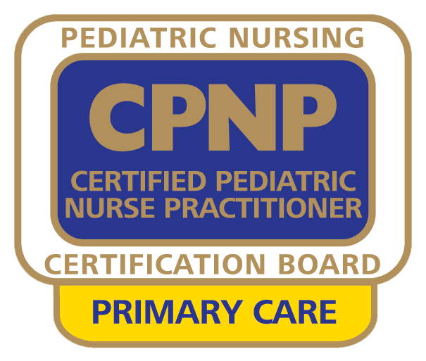
History and Purpose, cont.
The Job Task Analysis (JTA) uses a survey instrument to obtain descriptive information about the demographics and role responsibilities of primary care pediatric nurse practitioners.
This periodic study is required of all nursing certification boards by their accrediting agency and involves soliciting input from those who hold the credential. Their responses validate what is most prevalent and/or most important in practice for the role.
In keeping with best practices, PNCB conducts JTA studies every 4 to 7 years; the process involves roughly 9 months of planned events and key processes.
(Learn more here).

Slide 4

History and Purpose, cont.
In order to develop a content outline for the certification examination, the JTA study identifies tasks, knowledge areas, skills, or abilities deemed important for primary care pediatric nurse practitioners in various settings who provide care to the pediatric population, newborns through young adults.
A task appears on the updated content outline only if it meets validation criteria according to JTA study results.

Slide 5
What are the steps involved?
Over a period of several months between July 2022 and January 2023, the following occurred:
Development of the survey instrument with subject matter experts (SMEs) from around the country who hold the CPNP-PC credential. This involved:
Reflecting on trends in practice since the last study
Commenting on the current outline
Providing feedback or suggestions related to the delineation of practice
Pilot testing of the survey instrument for clarity and comprehensiveness.

Slide 6

What are the steps involved?
(cont.)
Dissemination of the survey to all actively-certified CPNP-PCs.
Analysis of survey data.
Development of test specifications and an updated content outline, using survey findings and input from the subject matter expert task force.
All PNCB certifications are accredited by the prestigious National Commission for Certifying Agencies (NCCA) and accepted for Magnet Recognition Program demographic data collection. Beware of other programs lacking accreditation.

Slide 7
The survey participants responded to these sections, or categories, of questions:
Survey Section | Rating
Screening | Yes/No
Tasks | Frequency and Importance
Domains | Percentage of Time and Importance & Percentage of CPNP-PC Examination
Knowledge Areas | Use-of Frequency and Importance
Procedures | Performance Frequency and Importance
Clinical Categories | Most and Least Encountered
Screening and Assessment Tools | Administered and/or Interpreted
Survey Comprehensiveness | Completeness of survey
Demographic / Professional Questions | Various Formats
Salary Questions | Various Formats
Gender, Ethnicity Questions | Various Formats

Slide 8
Results at a Glance
1,649
CPNP-PCs completed the survey
The most commonly earned degree was the Master's degree (81%)
69% of respondents worked more than 30 hours per week in direct care of pediatric patients
Almost half (49.3%) in Ambulatory Care in a Community Setting
This setting includes private practice, free medical clinic, mobile health, retail/urgent care, and federally qualified health centers
715 spent more than 50% of their time in a nursing subspecialty
Of those, about 4% were in Hematology/Oncology, followed by Develop-mental/Behavioral Pediatrics (3.7%) and Neonatology(3.7%)
Age, Gender, Ethnicity
83% identified as white
Most (83%) predominantly identified as female
More than half were under the age of 45
Other Data
38% had > 5 years of experience in pediatric PC
69% worked more than 30 hours/week in direct care
44.7% are practicing in an urban area.
Most survey participants indicated that the role of the primary care pediatric nurse practitioner providing services to children, adolescents, and young adults was adequately, very well, or completely covered.

Slide 9
Demographics of the CPNP-PC Over Time
 | 2017-2018 | 2022-2023
Primary Employment Setting | Private practice 45.60% Children’s hospital – outpatient clinic 15.5% Major medical center – outpatient clinic 5.8% Community hospital – outpatient clinic 5.7% Children’s hospital – inpatient 5.5% | Private Practice 38.10% Free-standing Children's Hospital – Outpatient 8.10% Academic Free-standing Children's Hospital – Outpatient 7.1% Federally Qualified Health Center 6.90% Community Hospital – Outpatient 6.90%
Highest Academic Degree in Nursing | Bachelor's Degree 1.6% Master's Degree 84.5% Doctoral Degree 13.5% Other < 1% | Bachelor’s degree < 1% ↓ Master's degree 81.10% ↓ Doctoral degree 18.20% ↑ Other < 1%
Top 5 Conditions Seen (in order) | Head, Eye, Ear, Nose, and Throat (HEENT) Dermatology Allergy Gastroenterology Developmental / Behavioral / Mental Health | Developmental, Behavioral, & Mental Health ↑ Dermatology Allergy/Immunology Otolaryngology ↓ Gastroenterology ↓

Slide 10
Demographics of the CPNP-PC Over Time
 | 2017-2018 | 2022-2023
Prescriptive Privileges | Full: Schedules II – V 62.6% Partial: Cannot prescribe Schedule II 26.6% Partial: Limited other Schedules (not II) 8.8% None: cannot prescribe medications 2% | Full: Schedules II – V 66.4% ↑ Partial: cannot prescribe Schedule II 22.4% ↓ Partial: limited other Schedules (not II) 8.4% ↓ None: cannot prescribe medications 2.7% ↑
Location of Practice Setting | Urban 45.7% Suburban 41.1% Rural 13.1% | Urban 44.7% ↓ Suburban 40.7% ↓ Rural/semi-rural 14.6% ↑
Top 5 States, by volume, where the Role is represented | Texas 12% California 7.3% New York 5.7% Illinois 4.9% Massachusetts 4.9% | Texas 8.4% New York 6.9% ↑ California 6.2% ↓ Florida 6.2% ↑ Ohio 5.3% ↑

Slide 11
Content Outline Impact
The description of the specialty was first reviewed by the JTA Task Force, and minor updates were made to reflect current terminology. Once updated, this description served as an anchor for all subsequent work.
Of the 59 tasks surveyed, all were included in the final content outline because they (1) met thresholds for validation or (2) were retained based on high-importance ratings from key subgroups.
Additionally, listings of clinical categories, procedures, and screening and assessment tools were also surveyed for validation and inclusion. Foundational knowledge areas were also surveyed and are now listed as foundational themes of the exam.
OVERALL

Slide 12
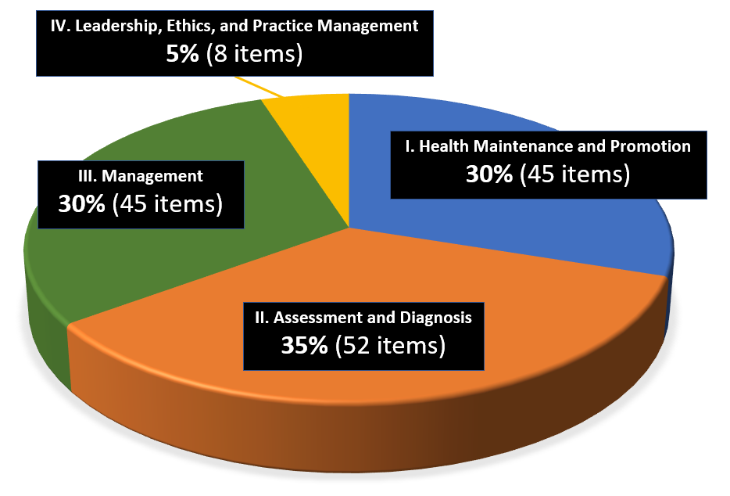
Content Outline Impact
The content domains, organized as follows, remain a four (4) domain structure with only slight naming variances in Domain IV only:
I. Health Maintenance and Promotion,
II. Assessment and Diagnosis,
III. Management, and
IV. Leadership, Ethics, and Practice Management
Subtle refinements were made throughout the outline of the tasks.
DOMAINS
Domain allocations of the updated 2022-2023 outline remain identical to those on the 2017-2018 outgoing CPNP-PC exam outline.

Slide 13
Content Outline Impact
By % of Items, # of Items per Domain
2018 Domain Structure | 2023 Domain Structure
Health Maintenance and Promotion 30% of the exam, at 45 scored items Assessment and Diagnosis 35% of the exam, at 52 scored items Management 30% of the exam, at 45 scored items Professional Role and Responsibilities 5% of the exam, at 8 scored items | Health Maintenance and Promotion 30% of the exam, at 45 scored items Assessment and Diagnosis 35% of the exam, at 52 scored items Management 30% of the exam, at 45 scored items Leadership, Ethics, and Practice Management 5% of the exam, at 8 scored items
= 150 items | = 150 items
=
DOMAINS

Slide 14
Content Outline Impact
All current tasks in the CPNP-PC detailed content outline were retained either as previously written or with minor editorial updates.
Added tasks include:
  Health Maintenance and Promotion
    Provide immunization counseling according to current national guidelines, including discussion of:
      Indications and contraindications
      Adverse effects
      Vaccine hesitancy
      Risks of non-adherence
  Assessment and Diagnosis
    Screening and assessment:
      Select, utilize, and interpret social determinants of health screening and assessment tools
      Select, utilize, and interpret disease-specific screening and assessment tools
TASKS

Slide 15
Content Outline Impact
Added tasks include (continued):
  Management
    Collaboration and Referral:
      Advocate on behalf of patients and families to improve health outcomes
  Leadership, Ethics, and Practice Management
    Leadership and Evidence-based Practice
      Advocate at the local, state, and federal levels in support of professional practice and/or issues that impact patient care
    Practice Management
      Increase access to care (e.g., provide access to interpreters, improve access for clients with various disabilities, facilitate transportation, extend appointment hours, telehealth)
TASKS

Slide 16
Content Outline Impact
CLINICAL CATEGORIES
1 | Developmental, Behavioral, & Mental Health
2 | Dermatology
3 | Allergy/Immunology
4 | Otolaryngology
5 | Gastroenterology
6 | Infectious Diseases
7 | Pulmonology
8 | Musculoskeletal/Orthopedic
9 | Nutrition
10 | Sexual and Reproductive Health
11 | Cardiology
12 | Neurology
13 | Pain
14 | Endocrinology
15 | Urology/Nephrology
16 | Child Maltreatment NEW
17 | Ophthalmology
18 | Environmental Health/Toxicology
19 | Hematology/Oncology
20 | Genetics
21 | Rheumatology
Developmental, Behavioral, & Mental Health jumped from the previous rank of 5 to rank 1.
Dermatology, Allergy (now combined with Immunology), Gastroenterology, and Otolaryngology (previously HEENT) remained among the most frequently seen diagnoses.
Child Maltreatment is a new clinical category (at rank 16).
Sexual and Reproductive health (at rank 10) was renamed from GYN, Reproductive Health, and Sexual Identity (and jumped from a lower rank since 2018).
Orthopedic is now part of Musculoskeletal/Orthopedic (rank 8)
Previously “Clinical Problems”, the listing of Clinical Categories retained all previous 18 categories and grew by 3 based on refinement of words or creating a standalone category that had been previously combined. Respondents were asked to rank their MOST frequently seen, and LEAST frequently seen. The order shown here represents the specific condition, by volume, represented on the exam.

Slide 17
Content Outline Impact
PROCEDURES
Exam content will include a focus on the following procedures (listed alphabetically).
Cerumen removal
Collect skin and body fluid specimens
Fluorescein staining
Fluoride application NEW
Incision and drainage
Reduction of nursemaid’s elbow
Removal of foreign body
Removal of sutures and staples
Umbilical cord cauterization
Wart removal
Twenty-seven (27) procedures and interventions were surveyed in the instrument asking respondents how frequently they had performed each in the past 12 months, from never to daily, and how important is it for entry-level primary care PNPs to be able to perform the procedure. Eight (8) met validation through a 5-point frequency scale, and 2 more were recommended by the Task Force to be retained.
Audiometry, rapid tests, STI testing, spirometry/pulmonary function test, and visual acuity (on the previous outline) did not meet the threshold and are no longer listed.

Slide 18
Content Outline Impact
SCREENING AND ASSESSMENT TOOLS NEW
Exam content will include a focus on the following screening and assessment tools (listed alphabetically):
Adverse Childhood Events (ACE) Questionnaire
Ages & Stages Questionnaire
Ages & Stages Questionnaire: Social-Emotional
Ask Suicide-Screening Questions
CRAFFT Alcohol and Substance Screening Tool
Edinburgh Postnatal Depression Scale (EPDS)
Generalized Anxiety Disorder 7-item scale (GAD-7)
Modified Checklist for Autism in Toddlers, Revised, with Follow-Up (M-CHAT-R/F)™
NICHQ Vanderbilt Assessment Scales [any version]
Patient Health Questionnaire (PHQ) [any version]
Pediatric Symptom Checklist (PSC)
Screen for Child Anxiety Related Emotional Disorders (SCARED)
New with this study, a listing of screening or assessment tools was surveyed and was considered validated for inclusion in the outline if at least 40% of the respondents either administered and/or interpreted the tool. A total of 11 tools met this criterion. A 12th tool (ACE) was recommended by the Task Force for inclusion and is also listed.

Slide 19

KNOWLEDGE AREAS
Overarching knowledge areas were validated in this study and are a new aspect of this updated CPNP-PC content outline.
The study asked those who held the CPNP-PC credential and answered the survey:
“How frequently did you use a knowledge area during the past 12 months?” and “How important is that knowledge area to entry-level primary care pediatric nurse practitioner practice?”
These overarching knowledge areas (next page) represent foundational information or “themes” upon which any item appearing on the exam form can be based. Be familiar with these themes when developing and implementing a study plan.

Slide 20




KNOWLEDGE AREAS NEW
Population Health | Clinical Decision Making | Child Development and Family-Centered Care | APRN Leadership
Diversity, equity, inclusion, and belonging Social determinants of health (SDOHs) Global, public, and community health Immigrant, refugee, and migrant health Infection control Immunization guidelines | Anatomy and physiology Pathophysiology Microbiology Epidemiology Pharmacology Advanced health assessment Diagnostic testing and screening (e.g., POC testing, lab tests, imaging) Clinical reasoning Care coordination approaches Complementary and integrative health Inter- and intra-professional collaboration | Growth and development Patient education techniques (e.g., adult learning theory, health literacy) Communication theories and techniques (e.g., motivational interviewing, therapeutic communication) Psychosocial risk factors Models of care (e.g., team-based care, trauma-informed care, family-centered, patient-centered) Family systems theory Adverse Childhood Experiences (ACEs) Cultural humility Patient safety | Evidence-based practice and quality improvement Ethics Leadership theory and approaches Advocacy techniques Professional accountability Federal, state, local regulations and laws Scopes of practice Licensure, credentialing, and privileging Health care systems (e.g., publicly funded, private) Billing and coding Informatics (e.g., patient portals, EMR/EHR) Telehealth

Slide 21
Exam Details
There were no changes in the number of questions
  150 scored items and 25 unscored items
  A candidate cannot distinguish between scored and non-scored questions.
There was no change in time allotment
  3.0 hours

Slide 22
FAQs
Q: When does the updated exam launch?
  A: New exam forms tied to the 2023 outline are expected to launch in October 2023. See PNCB’s website for specific dates and other details.
Q: Have the eligibility requirements changed as a result of this study?
  A: No, eligibility requirements have remained the same.
Q: Is there an advantage in taking one version of the exam over the other?
  A: No, both will equally assess your knowledge.

Slide 23
FAQs
Q: Will the updated outline include questions about COVID?
  A: While COVID is an extremely prevalent and important topic, national guidelines or recommendations regarding COVID may change more frequently than other foundational information or topics within the infectious disease clinical conditions category. JTA research did not collect specific data on the frequency- or management- of the condition. There would only be an item about this disease on the CPNP-PC exam if it could be supported by a textbook reference or national consensus guideline.
Q: Do I need to study differently with this updated outline?
  A: No, the reference list remains the same because the tasks listed on the new outline have not changed significantly from the previous outline.

Slide 24
If you have questions, please visit:
www.pncb.org or email exam@pncb.org
Our team will be glad to assist.
We wish you much success on your upcoming exam.
May 2023

