Slide 1

2020-2021 Job Task Analysis for the Pediatric Primary Care
Mental Health Specialist (PMHS®) Exam
What is it, and why do it?

Slide 2
Purpose of the Study
update and validate the inventory of tasks performed by advanced practice nurses (APRNs) with specialty expertise who provide DBMH services to children, adolescents, and young adults;
update the existing inventory of diagnoses presented by patients;
update the existing inventory of pharmacologic agents prescribed or monitored as well as the treatments and interventions performed or monitored;
update the inventory of screening and assessment tools used by APRNs in the specialty;
update and expand the inventory of social determinants of health (SDOH) by including adverse childhood events (ACEs) that may impact patient health; and
develop updated test specifications and a detailed content outline for the PMHS examination.

Slide 3
History and Purpose, cont.
The inaugural role delineation of the Pediatric Primary Care Mental Health Specialist was performed in 2009-2010, and
In order to receive or maintain accreditation for an exam, accrediting agencies require this periodic study.
In keeping with best practices, PNCB conducts JTA studies every 4-7 years.
For the PMHS credential, this 2020-2021 study represents only the second ever follow-on job analysis, with new refinements.
2009-2010
2016-2017
2020-2021

Slide 4


History and Purpose, cont.
In order to develop a content outline for the certification examination, the JTA study identifies tasks, knowledge, skills, or abilities deemed to be important to APRNs who provide developmental, behavioral, and mental health services to children, adolescents, and young adults.
A task appears on the updated content outline only if it met validation criteria according to JTA study results.

Slide 5
What are the steps involved?
Over a period of several months between July 2020 and January 2021, the following occurred:
Development of the survey instrument with subject matter experts (SMEs) from around the country. This involved:
Reflecting on trends in practice since the last study
Commenting on the current outline
Providing feedback or suggestions related to the delineation of practice
Pilot testing of the instrument for clarity and comprehensiveness.

Slide 6
What are the steps involved?
(cont.)
Dissemination of the survey to
all actively-certified PMHSs,
all PNCB-certified Primary Care Pediatric Nurse Practitioners (CPNP-PCs) who did not otherwise hold the credential, and
a volunteer sample of the Family Nurse Practitioners (FNPs) certified by the American Academy of Nurse Practitioners Certification Board (AANPCB)
Analysis of survey data
With input from the SMEs, development of test specifications and the updated content outline from survey finding.

Slide 7
The survey participants responded to these sections.
Survey Section | Rating
Screening | Yes/No
Tasks | Frequency and Importance
Domains | Percentage of Time and Importance & Percentage of PMHS Examination
Diagnoses | Percentage of Patients
Risk Factors (SOHs and ACEs) | Percentage of Patients
Pharmacologic Agents | Actions Performed
Therapies and Interventions | Actions Performed
Screening and Assessment Tools | Actions Performed
COVID-related Changes in Practice | Write-in Response
Survey Comprehensiveness | Completeness of survey
Demographic/Professional Questions | Various Formats
Salary Questions (PHMS only) | Various Formats
Eligibility Criteria Questions | Various Formats
In addition to the delineation of practice, questions were also included on the PMHS eligibility criteria as well as a brief salary survey.

Slide 8
Results at a glance.
993 APRNs completed the survey
35.8% of the entire PMHS-certified population (at the time) participated.
64.9% of respondents worked in Primary Care settings
This includes primary care family practices, pediatrics, and adolescent medicine.
8.6% worked in Develop-mental / Behavioral Pediatrics
This includes outpatient clinics or specialty practices.
On average, respondents spent 82% of their time in direct patient care
Administration and supervisory activities were at 8.5%, followed by faculty / education at 7.5% and research at 2.4%.
Other Data
64% prescribe schedule II medications.
50% bill for services in their own name.
42% are practicing in a suburban area.
Most survey participants indicated the role of the APRN providing services to children, adolescents, and young adults with developmental, behavioral, or mental health (DBMH) concerns was adequately to very well covered.

Slide 9
Demographics of the PMHS Over Time…
 | 2016-2017 | 2020-2021
Practice Setting | Primary Care Clinics 55.2% Developmental/Behavioral Pediatrics Clinics 12.2% Pediatric Outpatient Clinic or Specialty Practice 11.5% Psychiatry Outpatient Clinic or Specialty Practice 11.5% | Primary Care Clinics ↑ 64.9% Developmental/Behavioral Pediatrics Clinics ↓ 8.6% Pediatric Outpatient Clinic or Specialty Practice ↓ 10.2% Psychiatry Outpatient Clinic or Specialty Practice ↓ 4.6%
Location of Practice Testing | Urban 45.7% Suburban 42% Rural 12.6% | Urban ↓ 38.5% Suburban = 42% Rural ↑ 19.5%
Top 5 Referrals to Other Services | Counselor/Therapist 89% Child/adolescent psychiatrist 82.5% OT/PT/Speech 78.8% Neurologist 69.9% Pediatric psychologist 69.2% | Counselor/Therapist ↑ 93% Child/adolescent psychiatrist ↑ 86.9% OT/PT/Speech ↑ 80% Neurologist ↓ 65.5% Pediatric psychologist ↓ 62.4%
Top 5 States, by volume, where the Role is represented | California Ohio New York Minnesota Pennsylvania | Texas Ohio California New York Pennsylvania

Slide 10
Content Outline Impact
The description of the specialty was first reviewed, and minor updates were made to reflect current terminology. Once updated, this description served as an anchor for all subsequent work.
All 68 tasks that were surveyed met thresholds and were validated and/or were retained based on their high importance ratings from key subgroups, and thus, included on the final content outline.
Additionally, listings of diagnoses, risk factors, pharmacology agents, therapies and interventions, as well as screening and assessment tools were also surveyed for validation and inclusion.
OVERALL

Slide 11
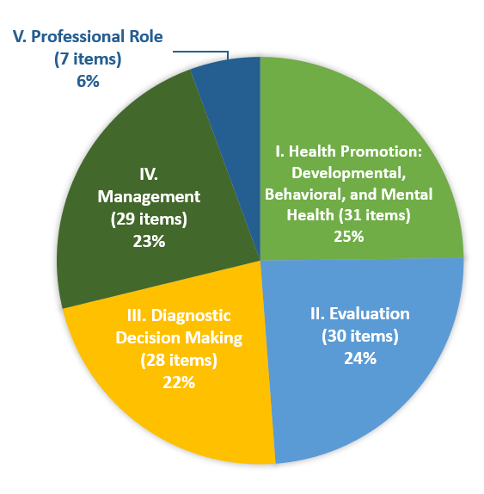
Content Outline Impact
The domain structure – organized by Health Promotion, Evaluation, Diagnostic Decision Making, Management, and Professional Role – remained the same but the allocation of content for each domain was revised slightly and subtle refinements made to the tasks.
DOMAINS
Allocations with the 2016-2017 study were Domain 1 (25%), unchanged; Domain 2 (23%), decreased by 1 percent; Domain 3 (23%), increased by 1 percent; Domain 4 (24%), decreased by 1 percent; Domain 5 (5%), increased by 1 percent.

Slide 12
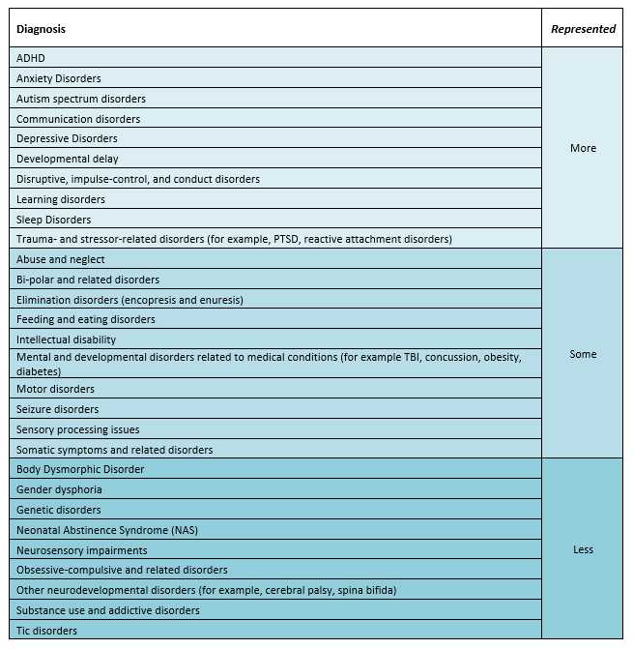
Content Outline Impact
Twenty-nine (29) of the 31 diagnoses surveyed were validated to appear on the content outline and were further grouped into three bands representing their likelihood of appearing on a given form of the examination. The top-ranked diagnoses (“MORE”) will appear most frequently to the exam candidate, followed by “SOME”, and “LESS”.
ADHD, Anxiety Disorders, Depressive Disorders Sleep Disorders, and Learning Disorders remained the most frequently seen diagnoses, and are represented in the “MORE” band.
NEW diagnosis inclusions as of the 2021 outline included:
Sensory Processing,
Body Dysmorphia, and
Neonatal Abstinence
DIAGNOSES

Slide 13
Content Outline Impact
Pharmacologic Agents:
At least 50% of respondents either recommended, prescribed, and/or monitored 9 of the 11 categories of pharmacologic agents surveyed.
This listing remains the same from the previous study:
Antidepressant medications
Anti-anxiety medications
ADHD medications
Over-the-counter medications
Sleep medications
Supplements (non-prescription)
Mood stabilizers
Antipsychotic medications
Antiepileptic medications
PHARMACOLOGIC AGENTS

Slide 14
Content Outline Impact
Treatments and Interventions:
At least 50% of respondents performed or monitored 8 of the 31 of the treatments and interventions surveyed. An additional 5 were performed or monitored by more than 50% of PMHSs, or at least one practice setting subgroup. This listing has increased from 6 in the previous study to the 13 now seen below. These appear below in descending, priority order:
Diet and nutritional approaches
Time management and limit setting NEW
Technology/electronics management NEW
Counseling for lifestyle management NEW
Motivational interviewing
Educational support services, including counseling about accommodations
Physical activity NEW
Sleep management NEW
Collaborative problem solving
Mind-body approaches, including mindfulness and relaxation therapy NEW
Behavioral interventions
Cognitive behavioral techniques
Psychoeducation NEW
TREATMENT AND INTERVENTIONS

Slide 15
Content Outline Impact
Assessments and Screening Tools: ACT recommended a testing threshold of at least 25% of respondents either administering or interpreting the assessment (or both) in either the total sample or in the PMHS subgroup. Nine universal screening tools and six behavioral and mental health risk-related tools met the threshold.
Universal Screening tools
Patient Health Questionnaire (PHQ, PHQ-9, etc.)
Modified Checklist for Autism in Toddlers, Revised, with Follow-Up (M-CHAT-R/F)™
Ages & Stages Questionnaire (ASQ)
Home environment, Education and employment, Eating, peer-related Activities, Drugs, Sexuality, Suicide/depression, and Safety from injury and violence (HEEADSSS)
CRAFFT Alcohol and Substance Screening Tool
Pediatric Symptom Checklist (PSC)
Ages & Stages Questionnaire: Social-Emotional (ASQ-SE)
Adverse Childhood Events (ACE) Questionnaire NEW
Parent Evaluation of Developmental Status (PEDS) NEW
ASSESSMENT AND SCREENING TOOLS
Risk-Related Tools - Behavioral and Mental Health
Vanderbilt Assessment Scales
Generalized Anxiety Disorder 7-item scale (GAD-7) NEW
Screen for Child Anxiety Related Emotional Disorders (SCARED)
Beck Depression Inventory (BDI) NEW
Conners Comprehensive Behavior Rating Scales (CBRS)
Child Behavior Checklist (CBCL)

Slide 16
Exam Details
There were no changes in the number of questions
  125 scored items and 25 unscored items
  You will not be able to distinguish between scored and non-scored questions.
There was no change in time allotment
  2.5 hours

Slide 17
FAQs
Q: When does the updated exam launch?
A: The new exam will launch with the testing window beginning October 15, 2021.
Q: Do I need to study differently with this updated outline?
A: No, the reference list remains the same because the tasks listed on the new outline have not changed significantly from the previous one.
Q: Have the eligibility requirements changed as a result of this study?
A: No, eligibility requirements have remained the same.
Q: Where can I confirm my eligibility?
A: Visit PNCB’s website for more information: https://www.pncb.org/pmhs-exam-eligibility

Slide 18

If you have questions, please visit:
www.pncb.org or email exam@pncb.org.
Our team will be glad to assist.
We wish you much success on your upcoming exam.
Updated 08242021

